Slide 1
TASK MANAGEMENT
COMPLETE YOUR TASKS….…

Slide 2
Abstract
Task management application is a software tool designed to help teams efficiently organize, track, and complete tasks. This application provides users with a central location to view and manage their to-do lists, and assign tasks to team members.
These applications typically developed for software companies it offers features such as task creation, assignment, scheduling as well as communication tools for team collaboration. This application allowing users to manage their tasks anytime and anywhere. Admin can create the department, assign tasks, set deadlines, track progress and also post notification.

Slide 3
These applications can be used in a variety of settings, including personal, academic, and professional environments. They can be especially useful for teams working on complex projects with multiple tasks and deadlines, as they provide a centralized platform for communication, task assignment, and progress tracking.
Overall, this application can help improve communication, and ensure that tasks are completed on time. It is a valuable tool for individuals and teams who want to streamline, their workflow and stay organized and it can help users increase their productivity, reduce stress, and improve their overall work performance

Slide 4
ASSIGN
SUBMIT
SHEDULE

Slide 5
INTRODUCTION

Slide 6
Purpose
The purpose of a Task management application is to help teams organize, track progress, and projects in order to increase productivity and efficiency, reduce the risk of tasks being overlooked or forgotten, and facilitate collaboration and communication among team members.

Slide 7
Scope
The scope of a Task management application is to provide features and functionality that help individuals and teams manage tasks and projects effectively, including task creation, assignment, and tracking progress, collaboration and communication, notifications, summary and feedback, and customization. The goal is to provide a centralized platform for organizing and managing tasks and projects, and to help users stay focused and productive.

Slide 8
Overview
A task management application is a software tool designed to help teams organize, and manage projects more effectively. These applications typically provide a range of features to help teams collaborate, track progress, and manage tasks.
These applications typically provide tools for creating, assigning, and tracking tasks. These tools often include features such as task lists, deadlines, and task dependencies.
It is often providing tools for team collaboration, such as team messaging, file sharing, and commenting on tasks. These features can help teams work together more effectively, even if they are geographically dispersed.

Slide 9
Overall, task management applications can be powerful tools for helping teams work together more effectively and efficiently. By providing features assign task, monitor the work progress, collaboration, and set deadlines, these applications can help teams stay organized, stay on track, and achieve their project goals.

Slide 10
SYSTEM ANALYSIS

Slide 11
Existing System
This system has poor user interface. This system has lack of robust reporting and analytics features, which makes it difficult to track progress and identify areas for improvement This system doesn’t Provide tracking of Employee statues and their progress. This manual system gives us very Less security for saving data and some data may be lost due to mismanagement. This application may be able to scale to meet the need of larger teams or organization. Most of the systems are paid.

Slide 12
Limitations of Existing System
This system doesn’t provide tracking of user’s activities and their progress.
Most of the systems are paid and no open source
This system doesn’t Provide tracking of Employee statues and their progress, Owner cannot monitor the work
This system only able large-scale organization
Poor reporting and analytics features make it difficult to track progress

Slide 13
Proposed System
The development of this new system contains the following activities, which try to Automate the entire process keeping in the view of database integration approach. This System maintains employee’s personal, address, and contact details. This system will Provide on line help and search capabilities. User friendliness is provided in the Application with various controls provided by system rich user interface. Authentication is Provided for this application only registered users can access. Event information files can Be stored in centralized database which can be maintained by the system. This system provides the employees to manage the events systematically and managers can easily create and share the notifications. It helps to monitor the employees and watch their work progress.

Slide 14
Advantages of Proposed System
Better user interface
Greater efficiency
Free and open source
User friendly

Slide 15
Hardware Requirements
The selection of hardware is very important in the existence and proper
working of any software. Then selection hardware, the size and capacity requirements are also important.
Processor : i3 or Above
System Bus : 32Bit or 64Bit
RAM : 4 GB or Above
HDD : 500 GB or Above
Monitor : 14” LCD or Above
Key Board : 108 Keys
Mouse : Any Type of mouse

Slide 16
Software Requirements
One of the most difficult tasks is selecting software for the system, once the system requirements is found out then we have to determine whether a particular software package fits for those system requirements.
The application Requirement:
Operating System : Windows 10 and 32 bit or 64 bit platform
Front-End : Python, HTML,CSS
Back-End : MySQL Workbench
Framework : Django
IDE : JetBrains PyCharm

Slide 17
SYSTEM DESIGN

Slide 18
Users of the System
Admin
Manager
Task Manager
Employee

Slide 19
Functions of Admin
Create Department
Register Employee
Assign Task
View Feedback
View and reply Complaint
View Summary
View Task status
View Department
View Employee status
Post Notification

Slide 20
Functions of Manager
View Task
Assign Task
View Employee status
View Admin reply
View Task manager complaint and reply
View Feedback
View Task status
View Notification
Post Notification
Post complaint
Post Summary and feedback
Edit Profile

Slide 21
Functions of Task Manager
View Task
Submit Task
Assign Task
View Employee status
View and reply Complaint
Post Complaint
View Manager reply
View Feedback
Post Feedback
View Task status
View Notification
Post Notification
Edit Profile

Slide 22
Functions of Employee
View Task
Submit Task
View Task manager reply
Post Complaint
Edit Profile

Slide 23
SCREENSHOTS

Slide 24
Login page

Slide 25
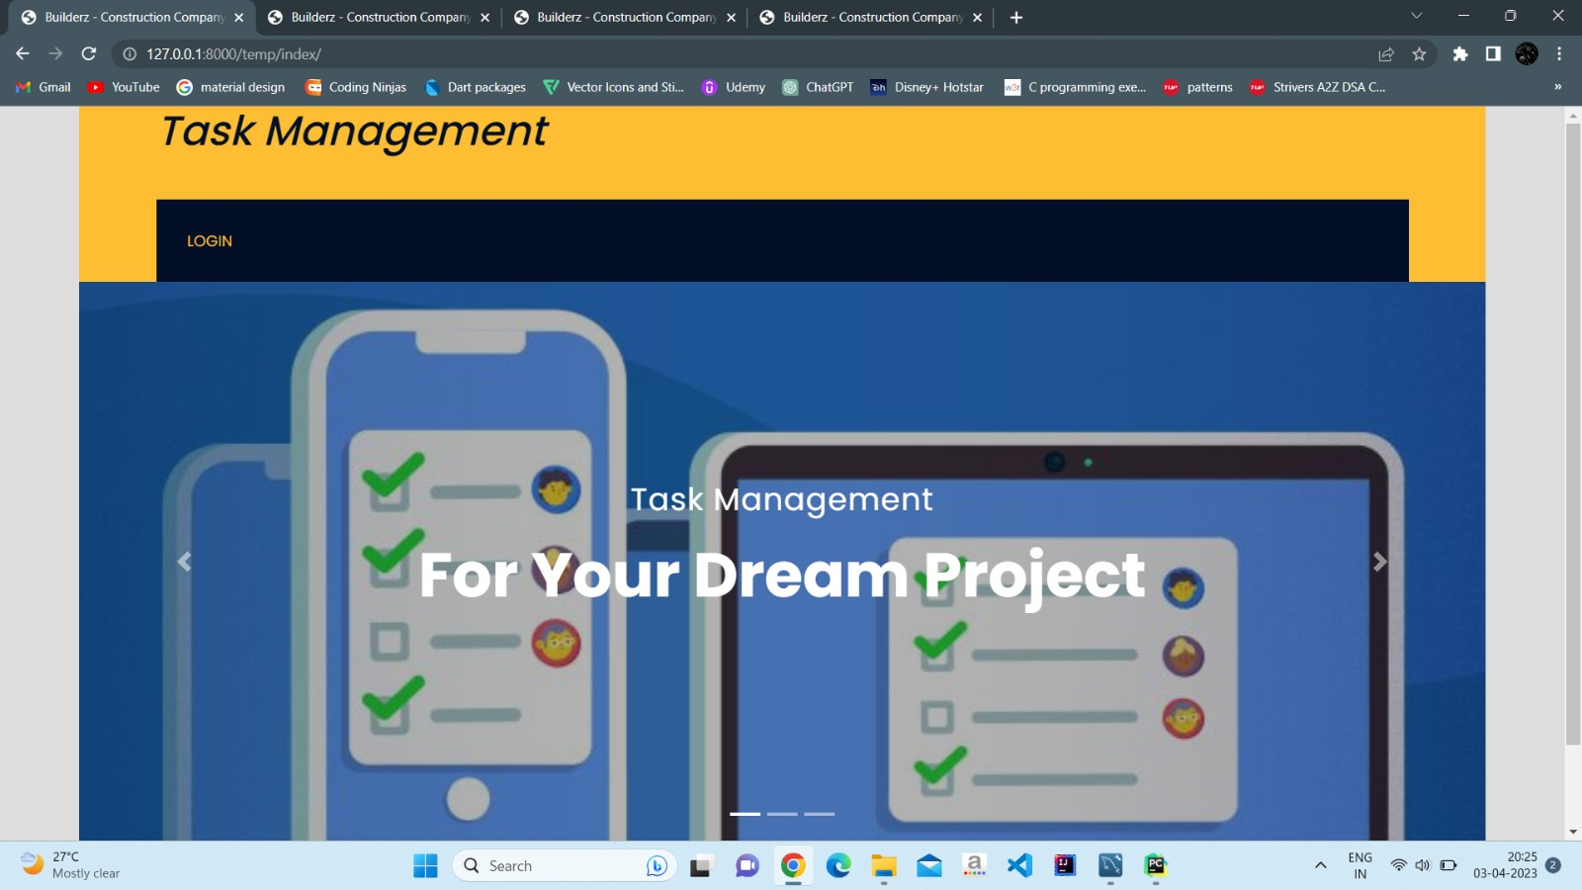

Slide 26
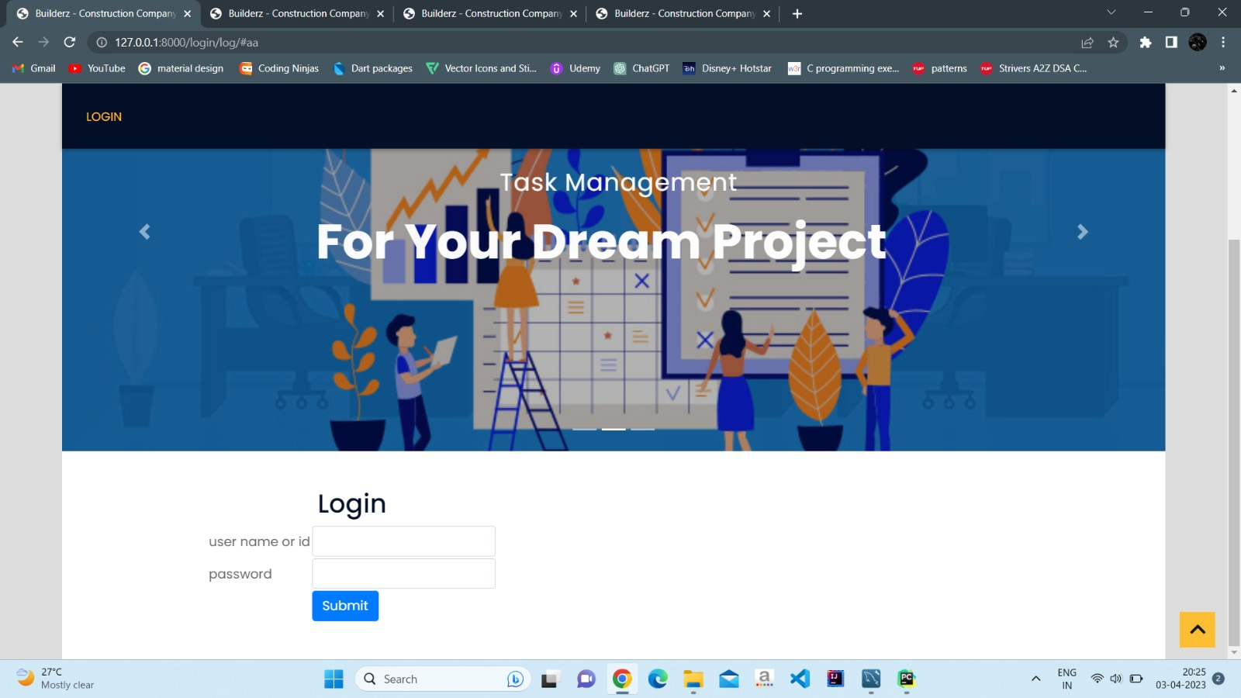

Slide 27
Admin page

Slide 28
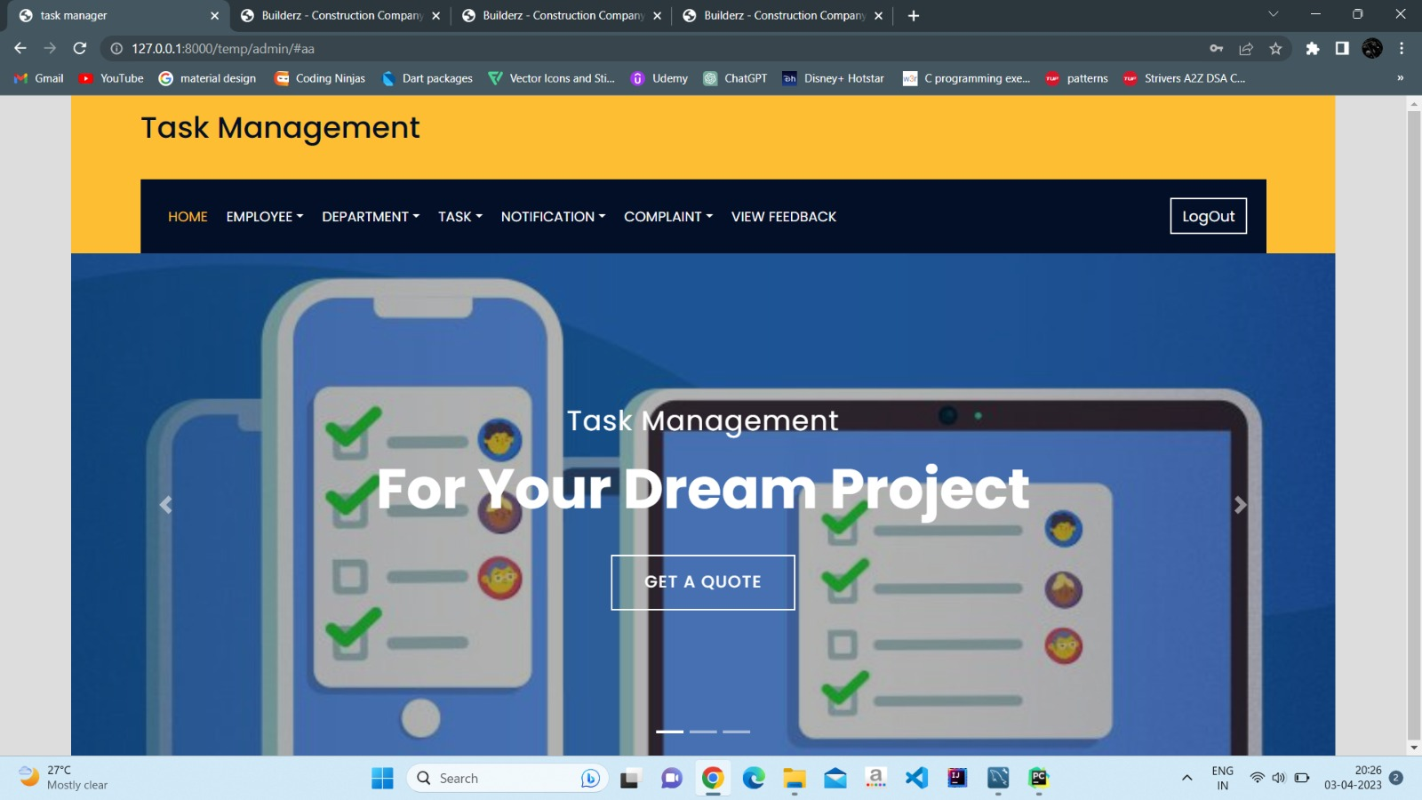

Slide 29
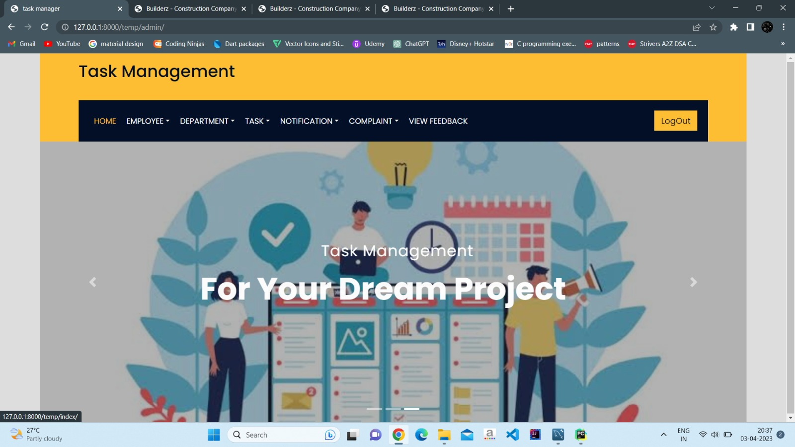

Slide 30
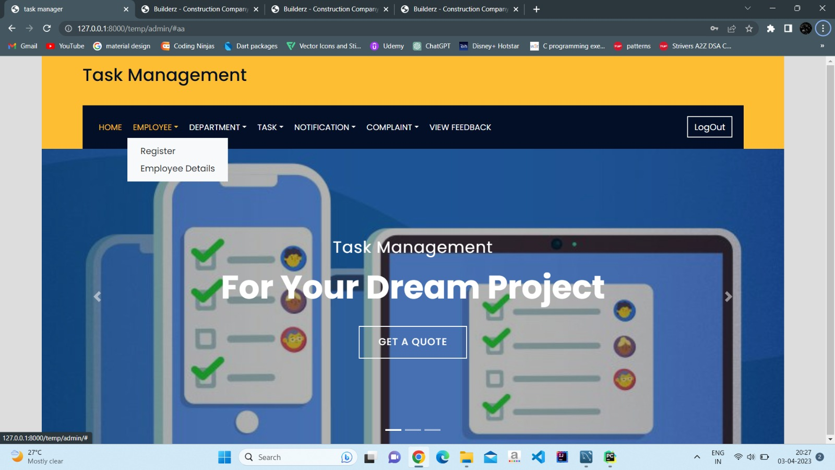

Slide 31
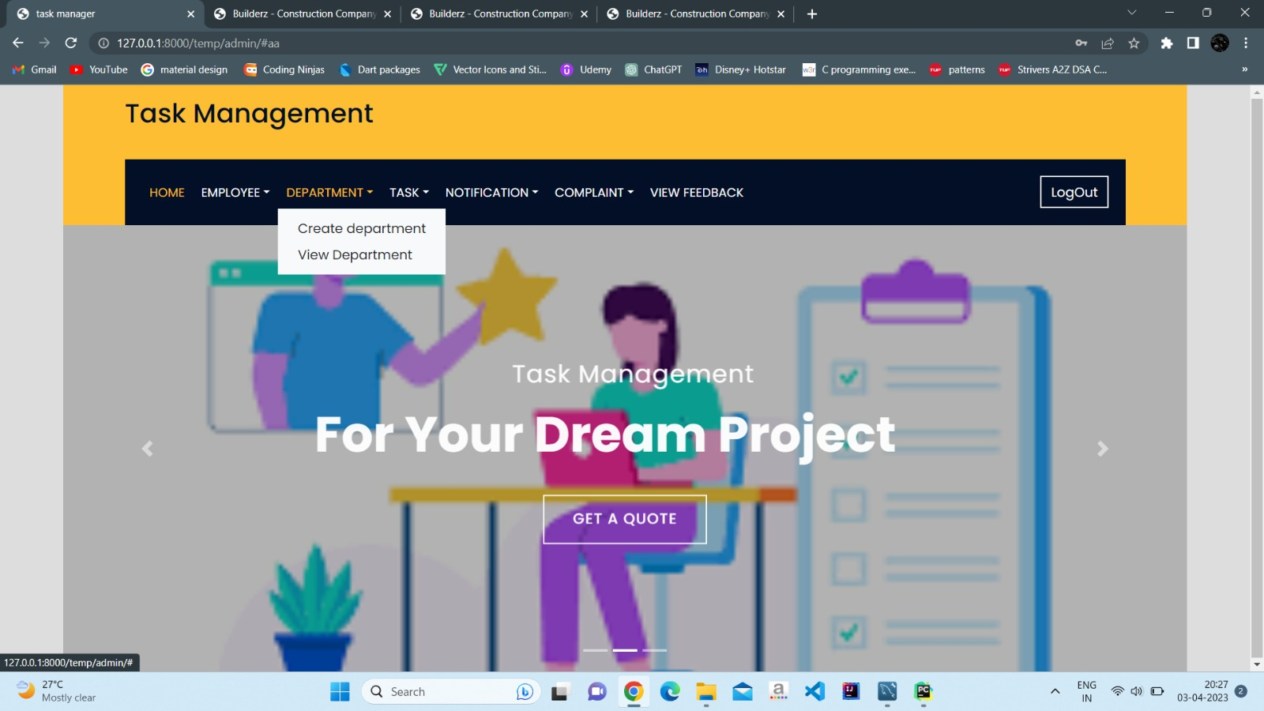

Slide 32
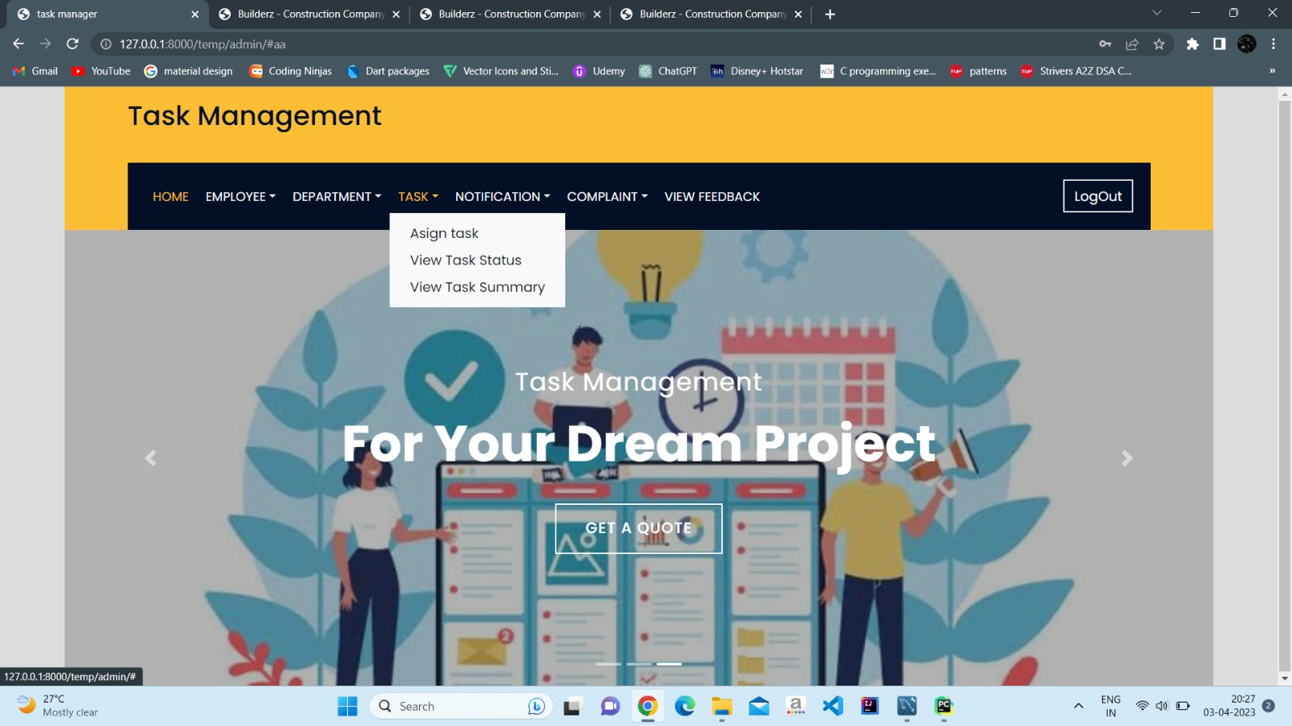

Slide 33
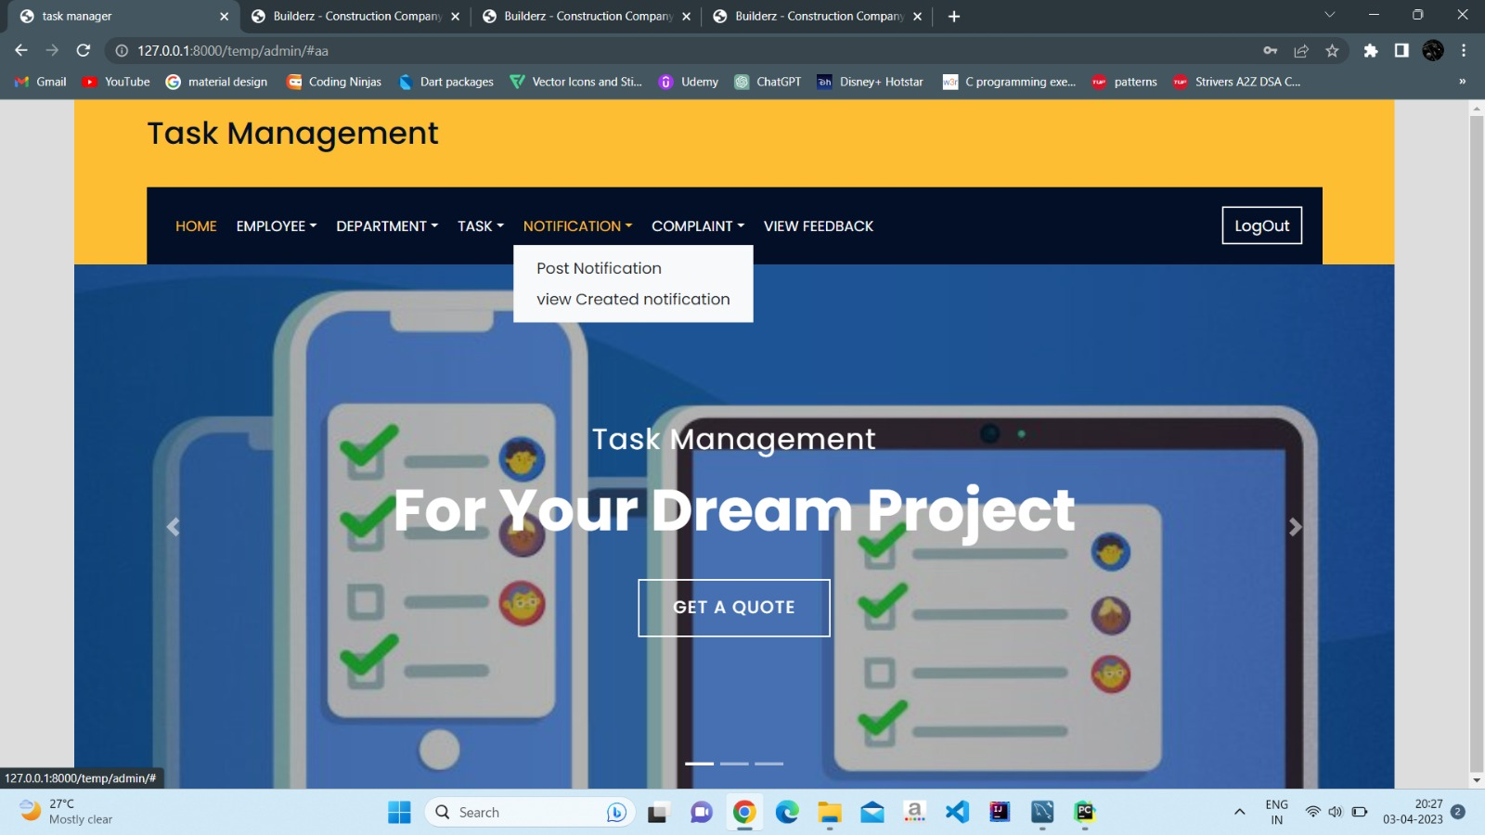

Slide 34
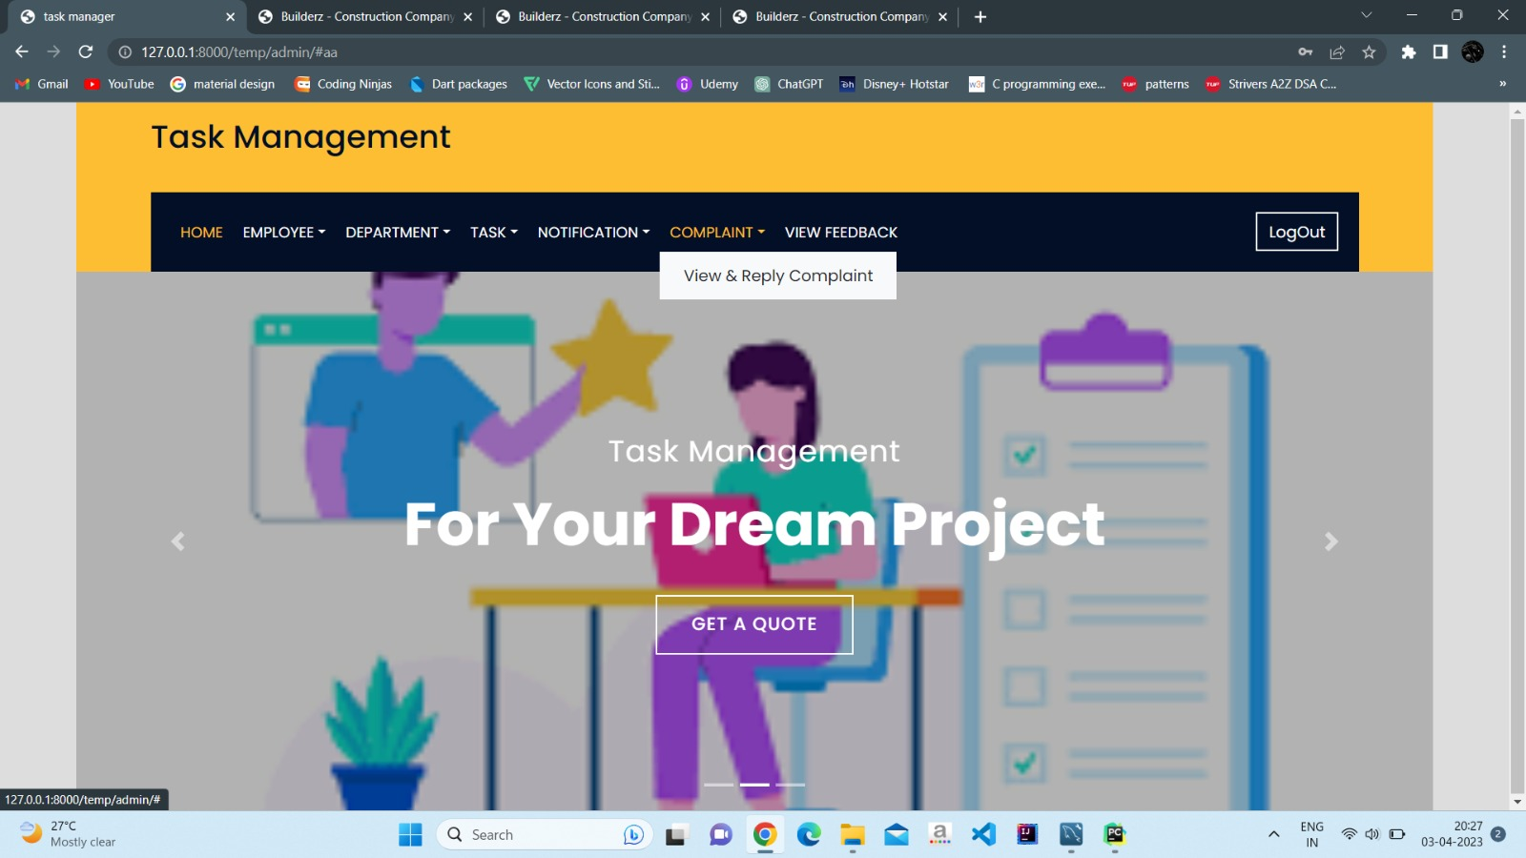

Slide 35
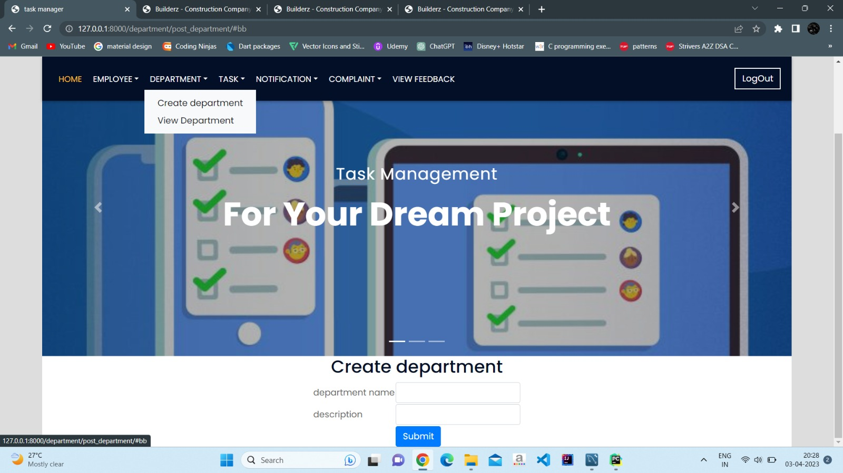

Slide 36
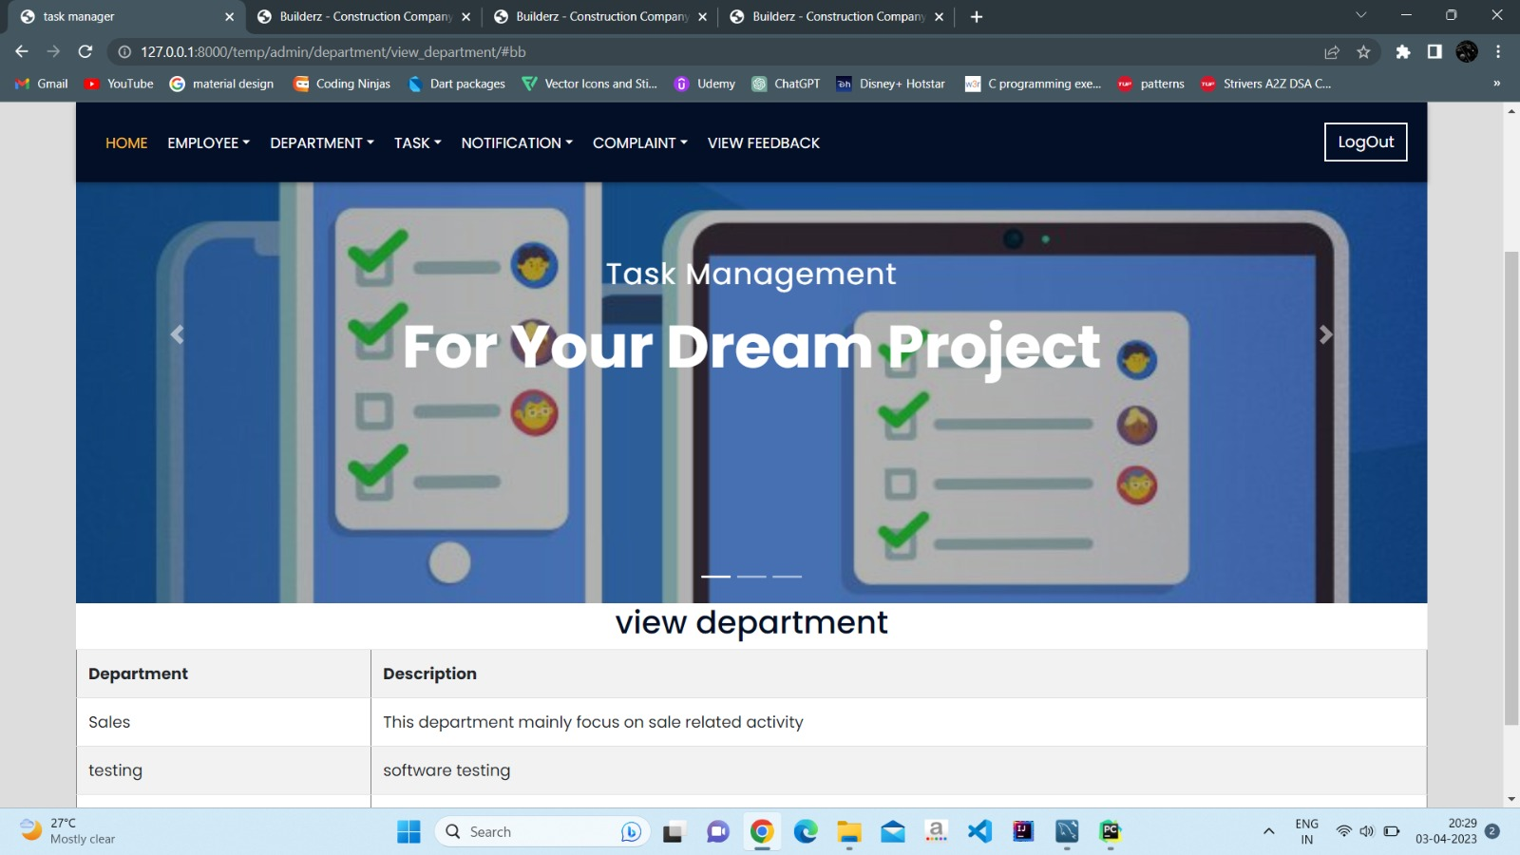

Slide 37
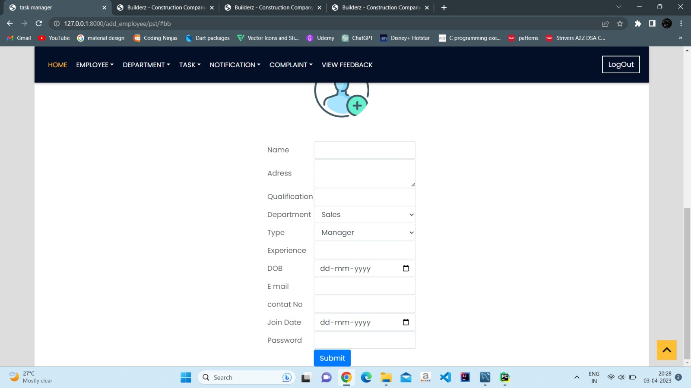

Slide 38
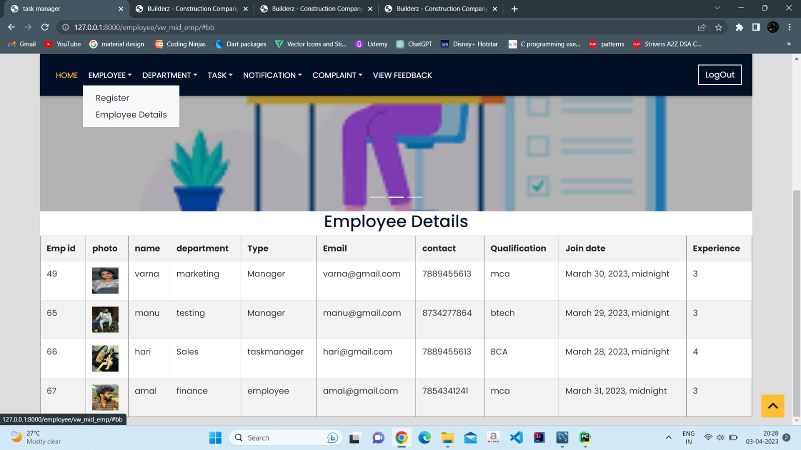

Slide 39
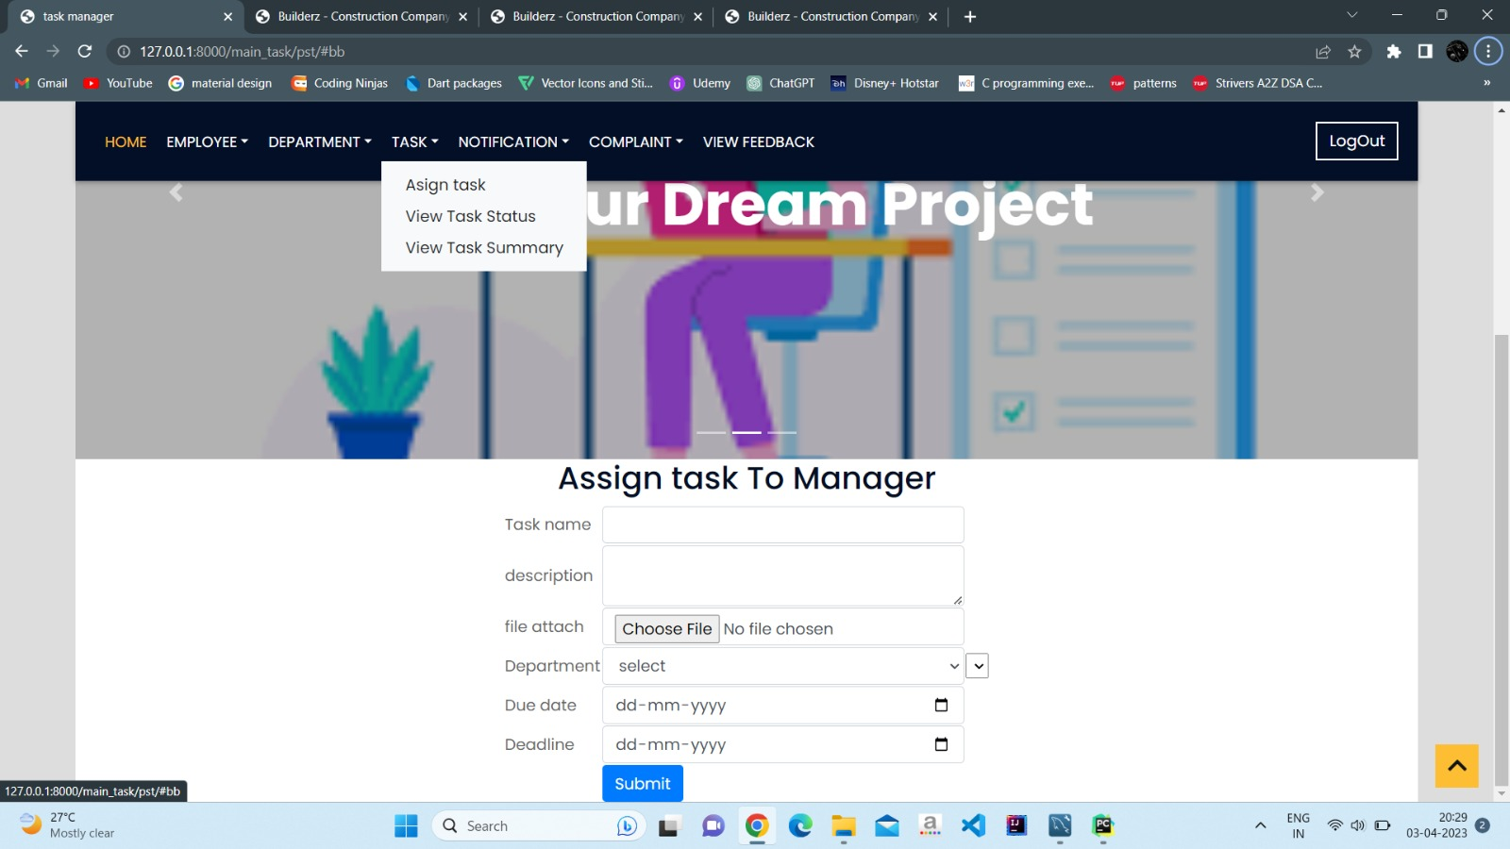

Slide 40
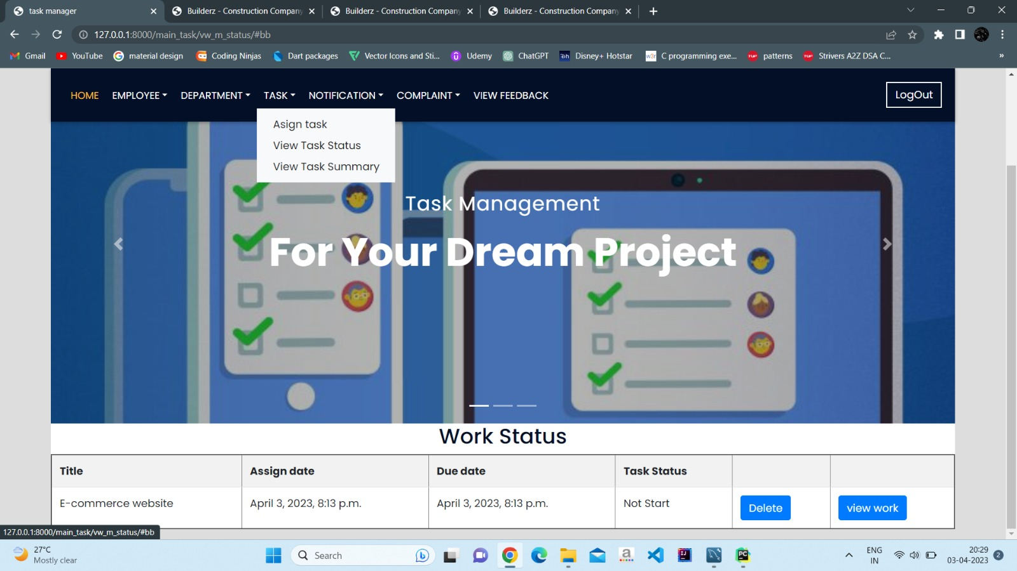

Slide 41
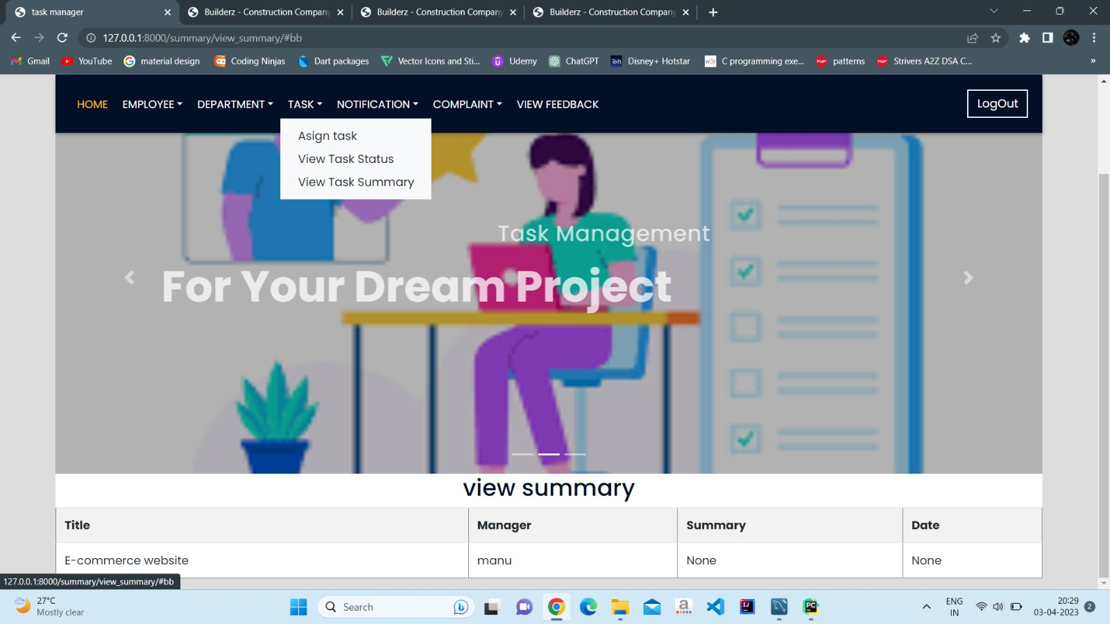

Slide 42
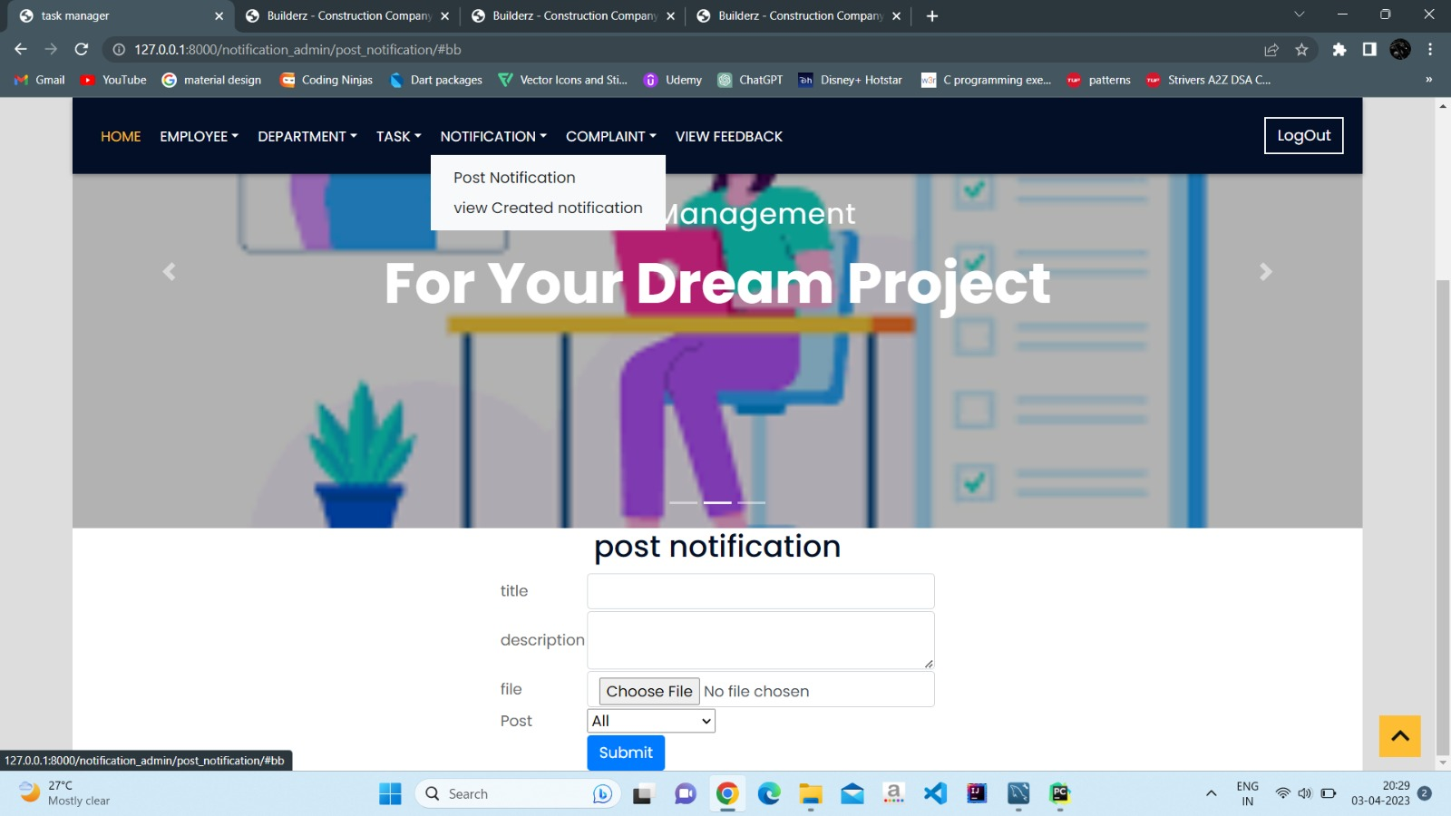

Slide 43
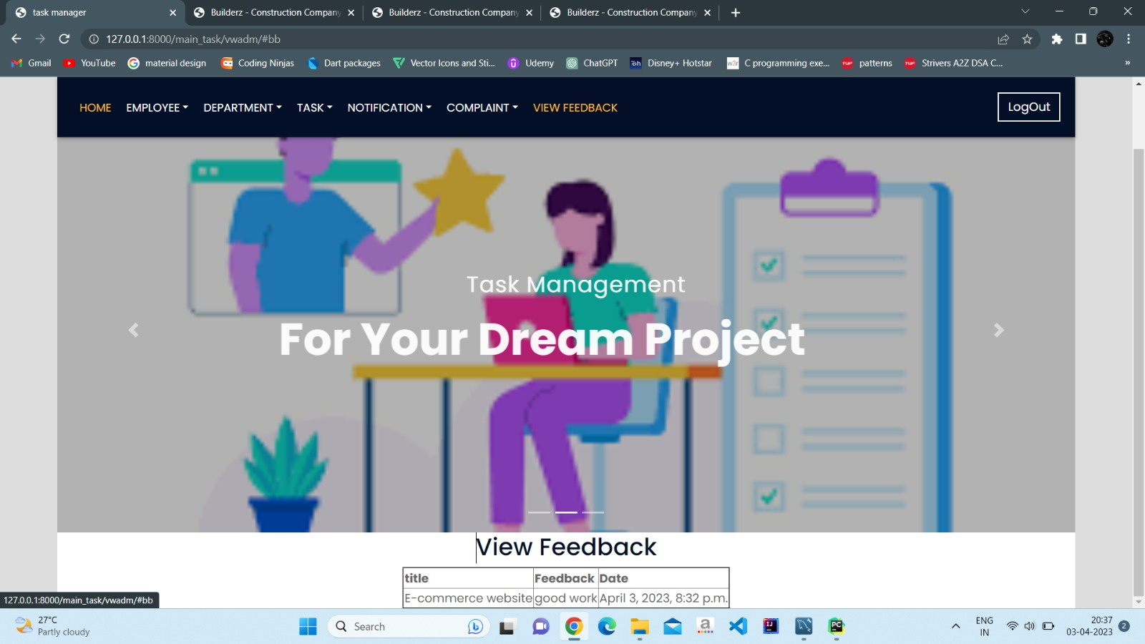

Slide 44
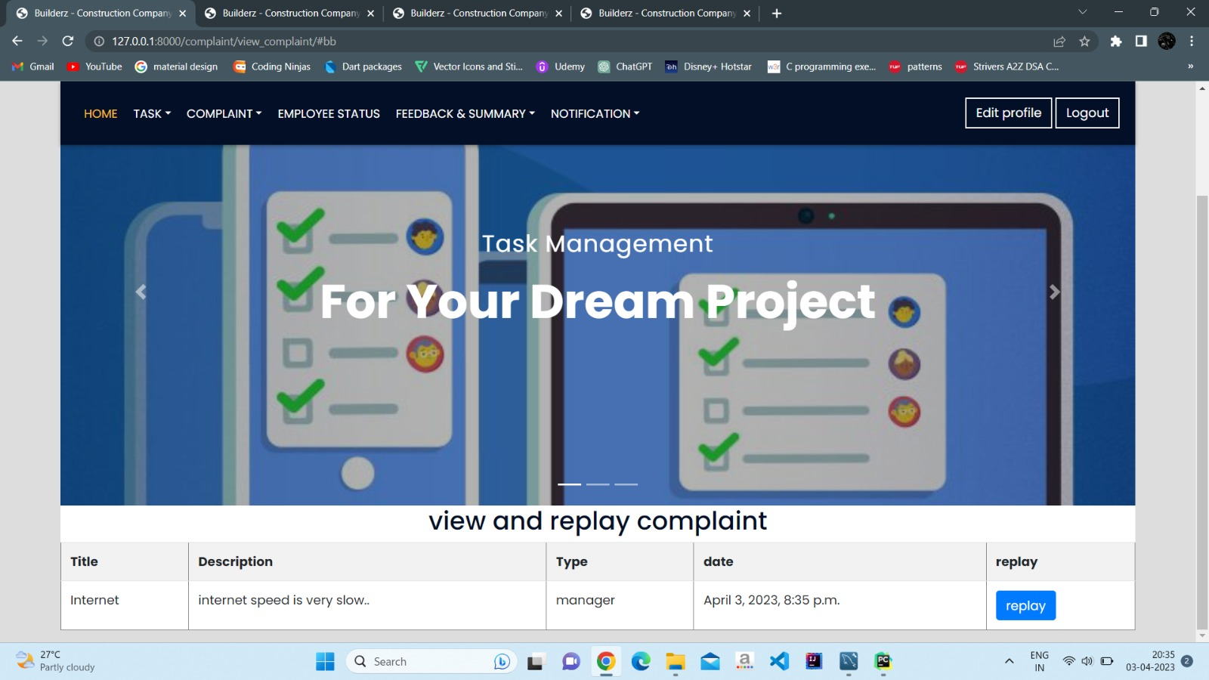

Slide 45
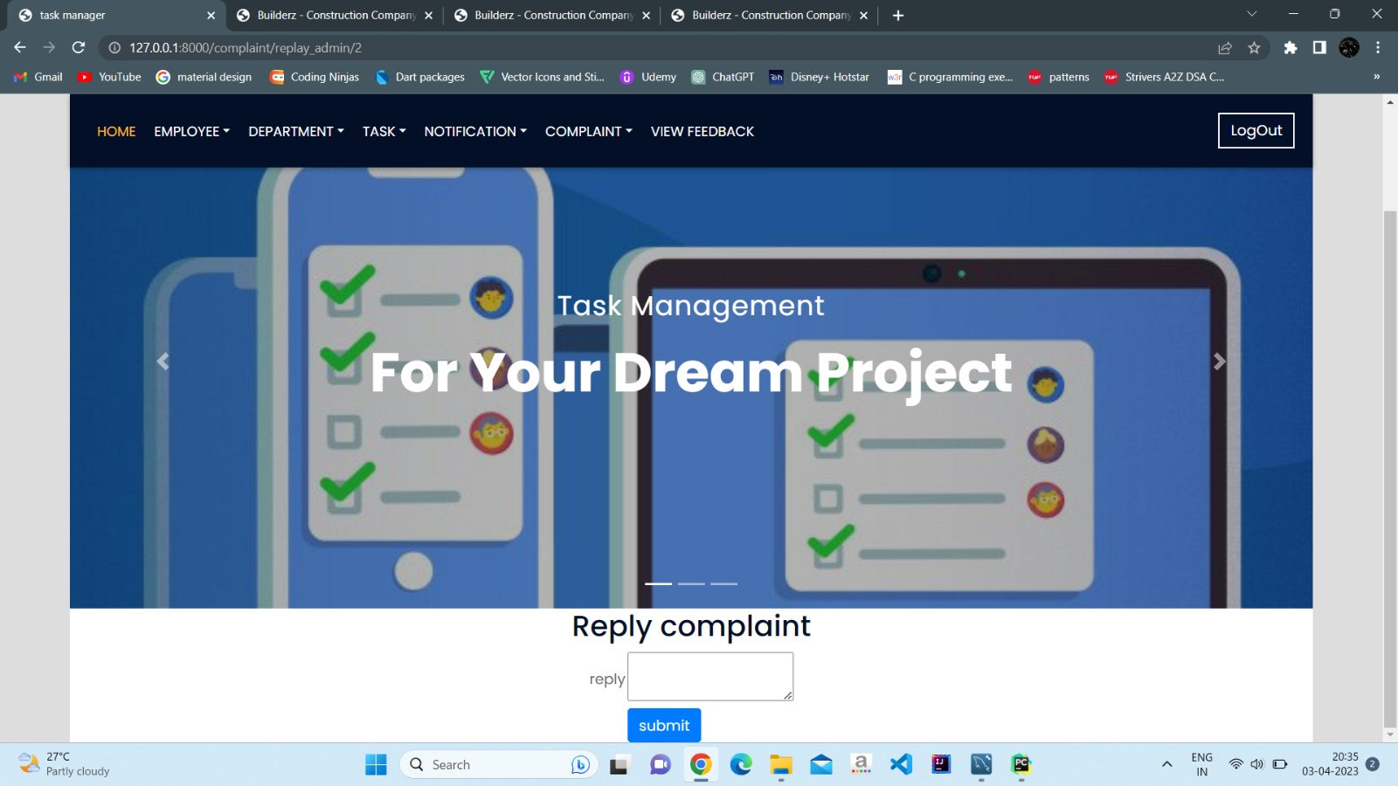

Slide 46
Manager page

Slide 47
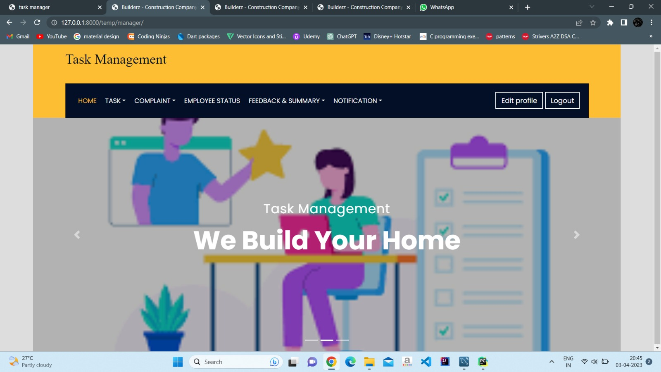

Slide 48
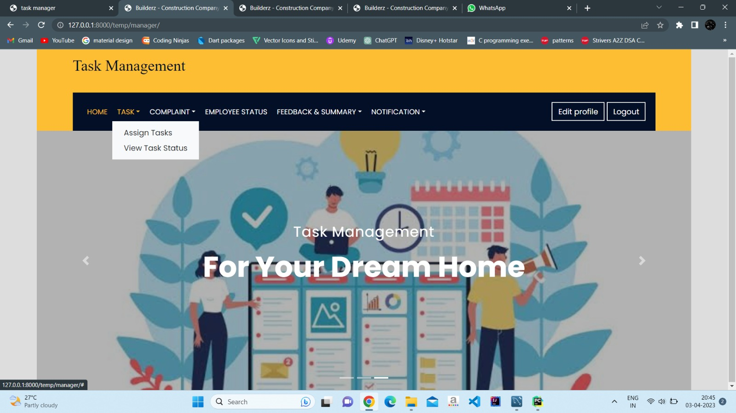

Slide 49
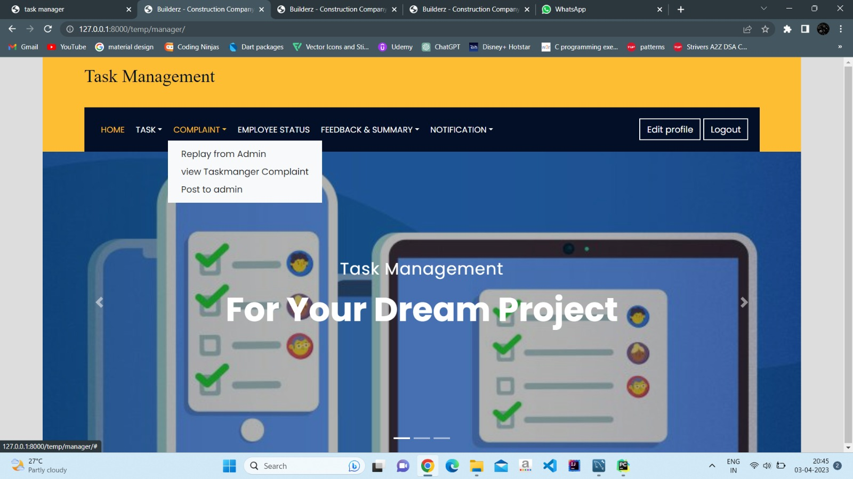

Slide 50
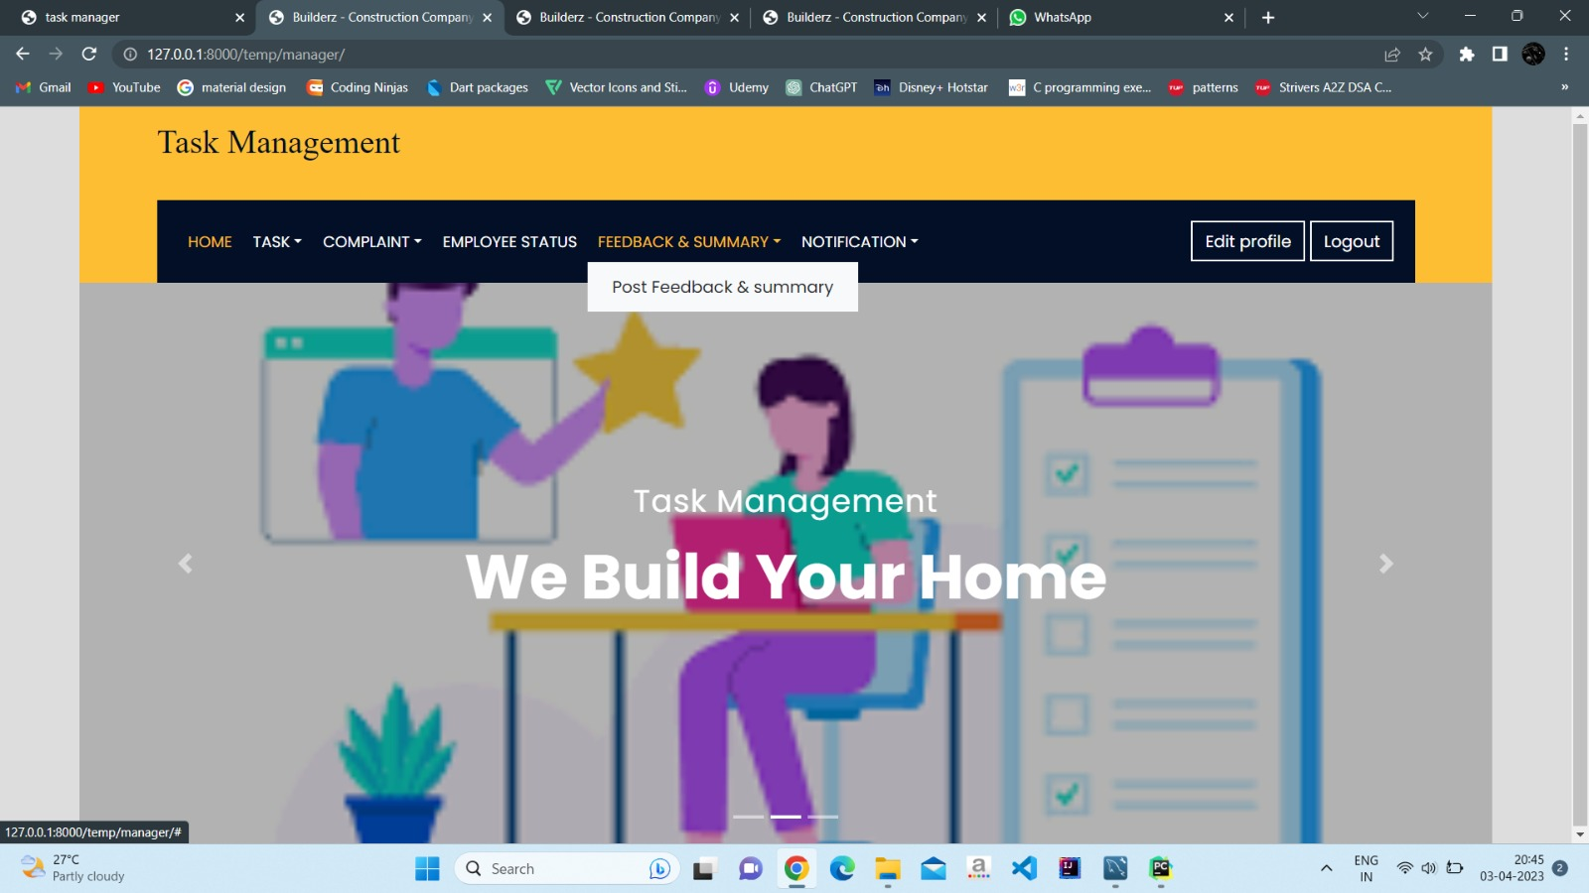

Slide 51
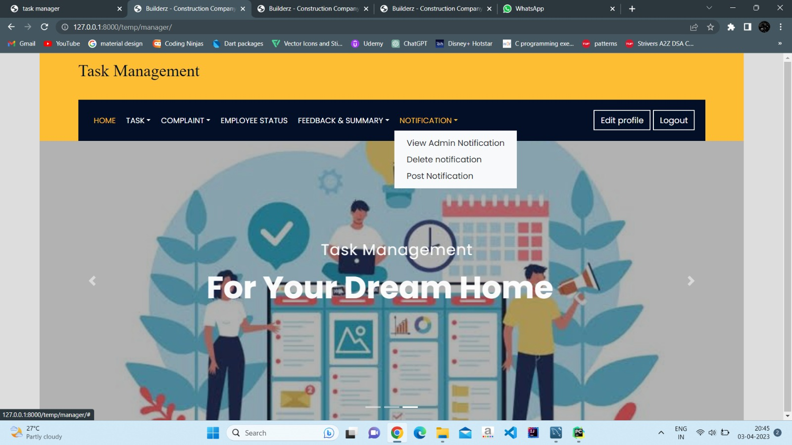

Slide 52
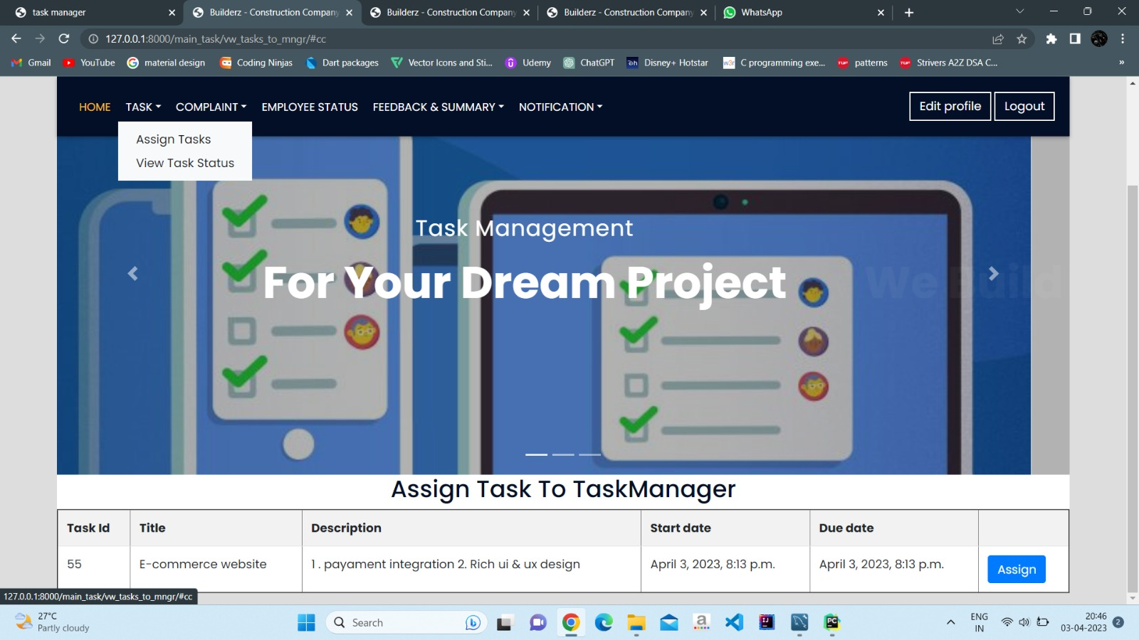

Slide 53
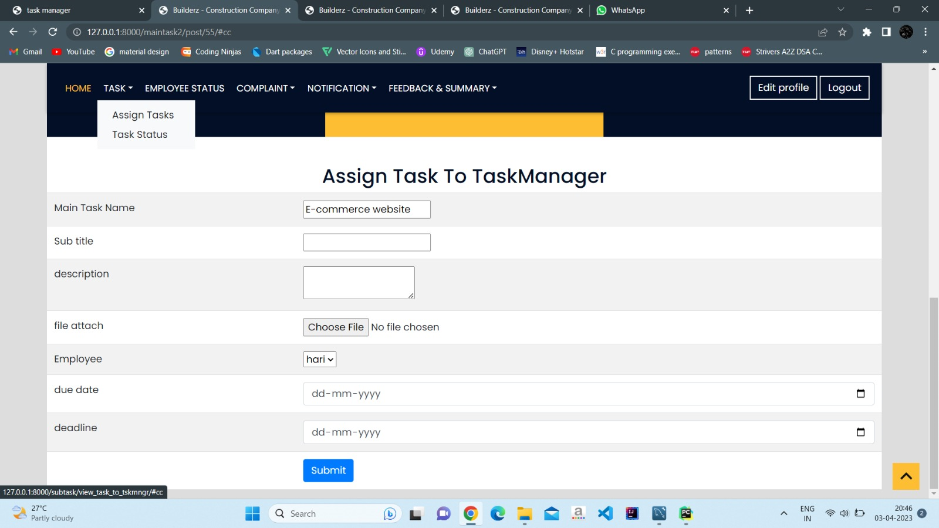

Slide 54
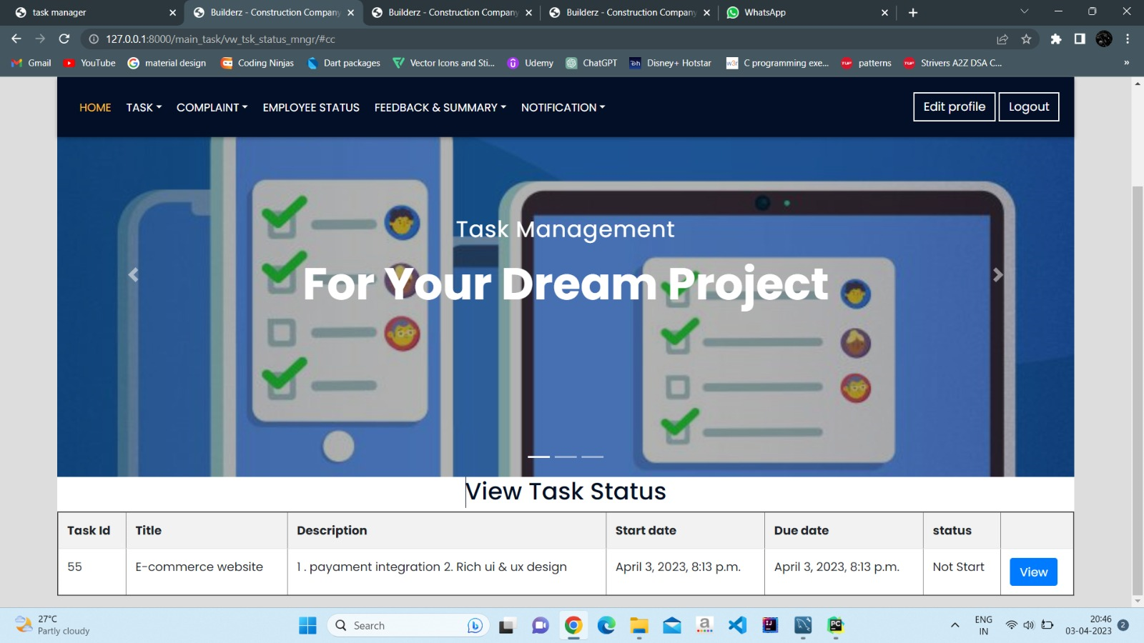

Slide 55
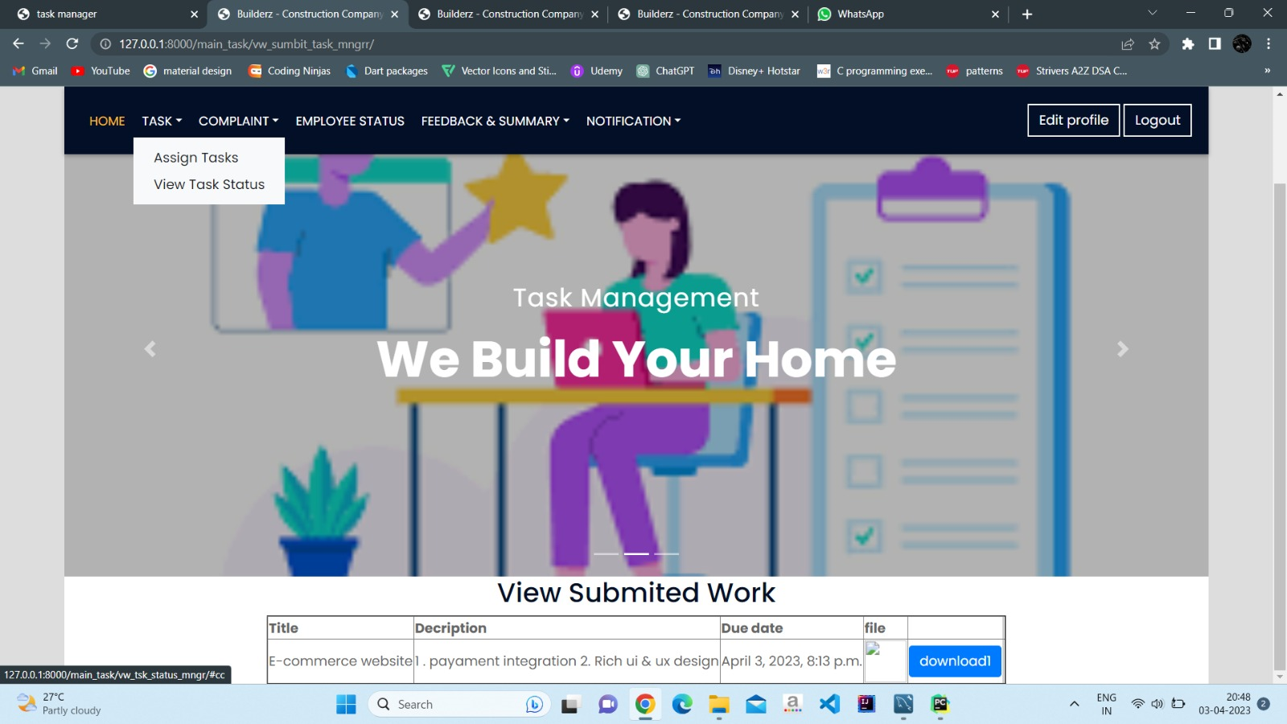

Slide 56
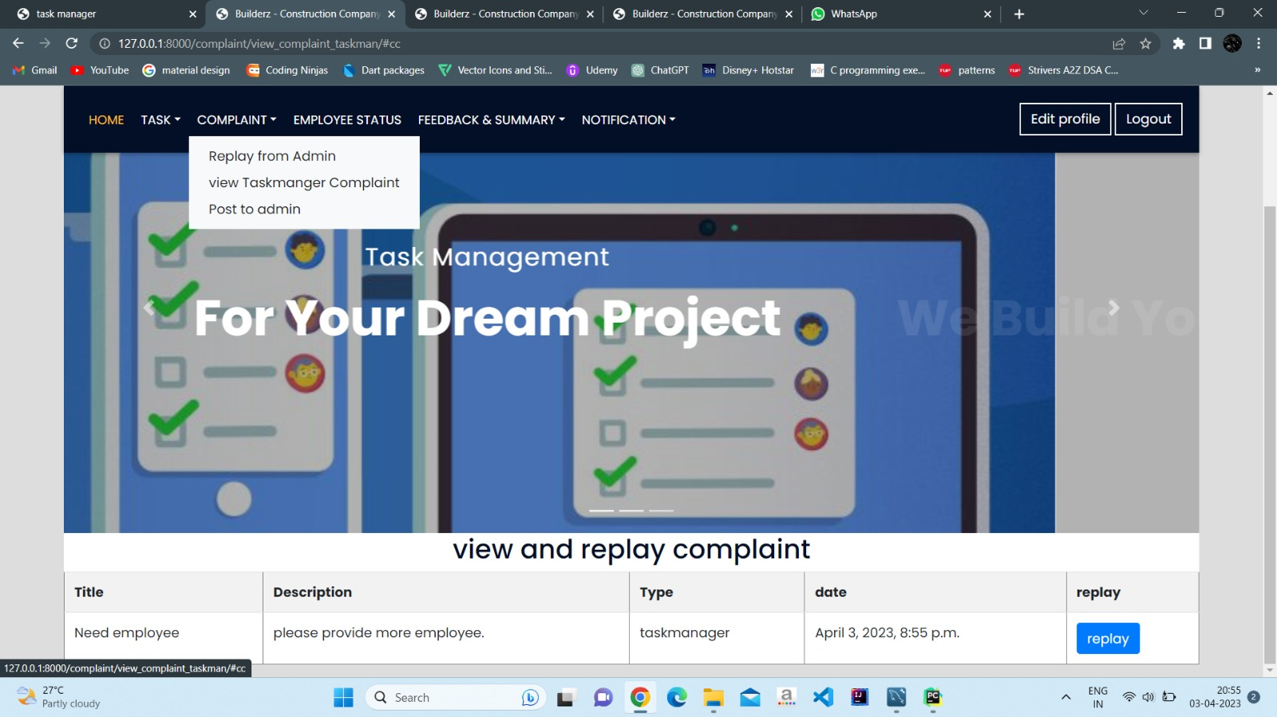

Slide 57
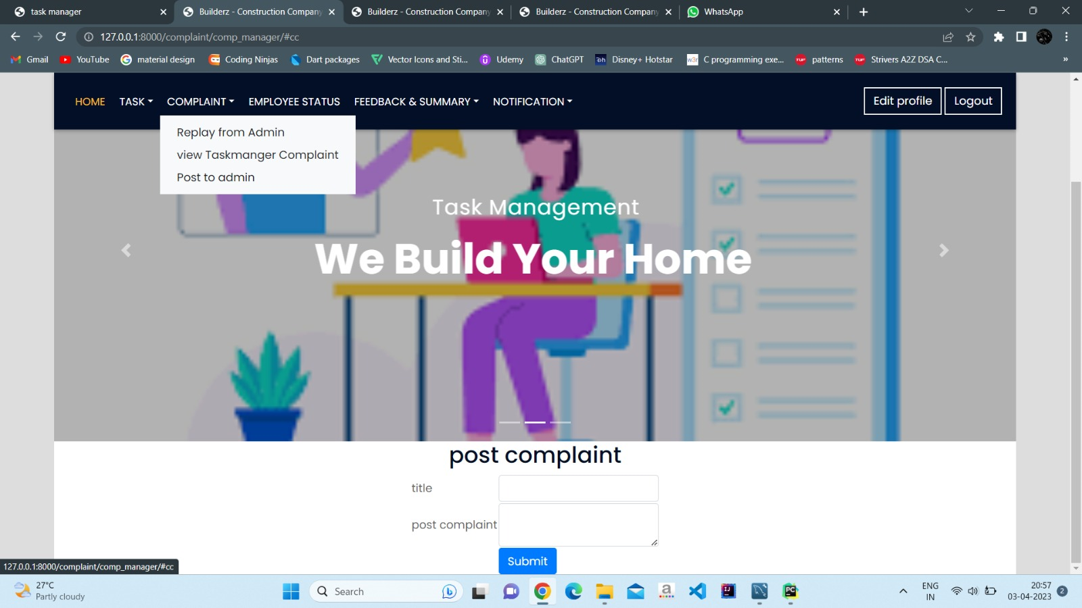

Slide 58
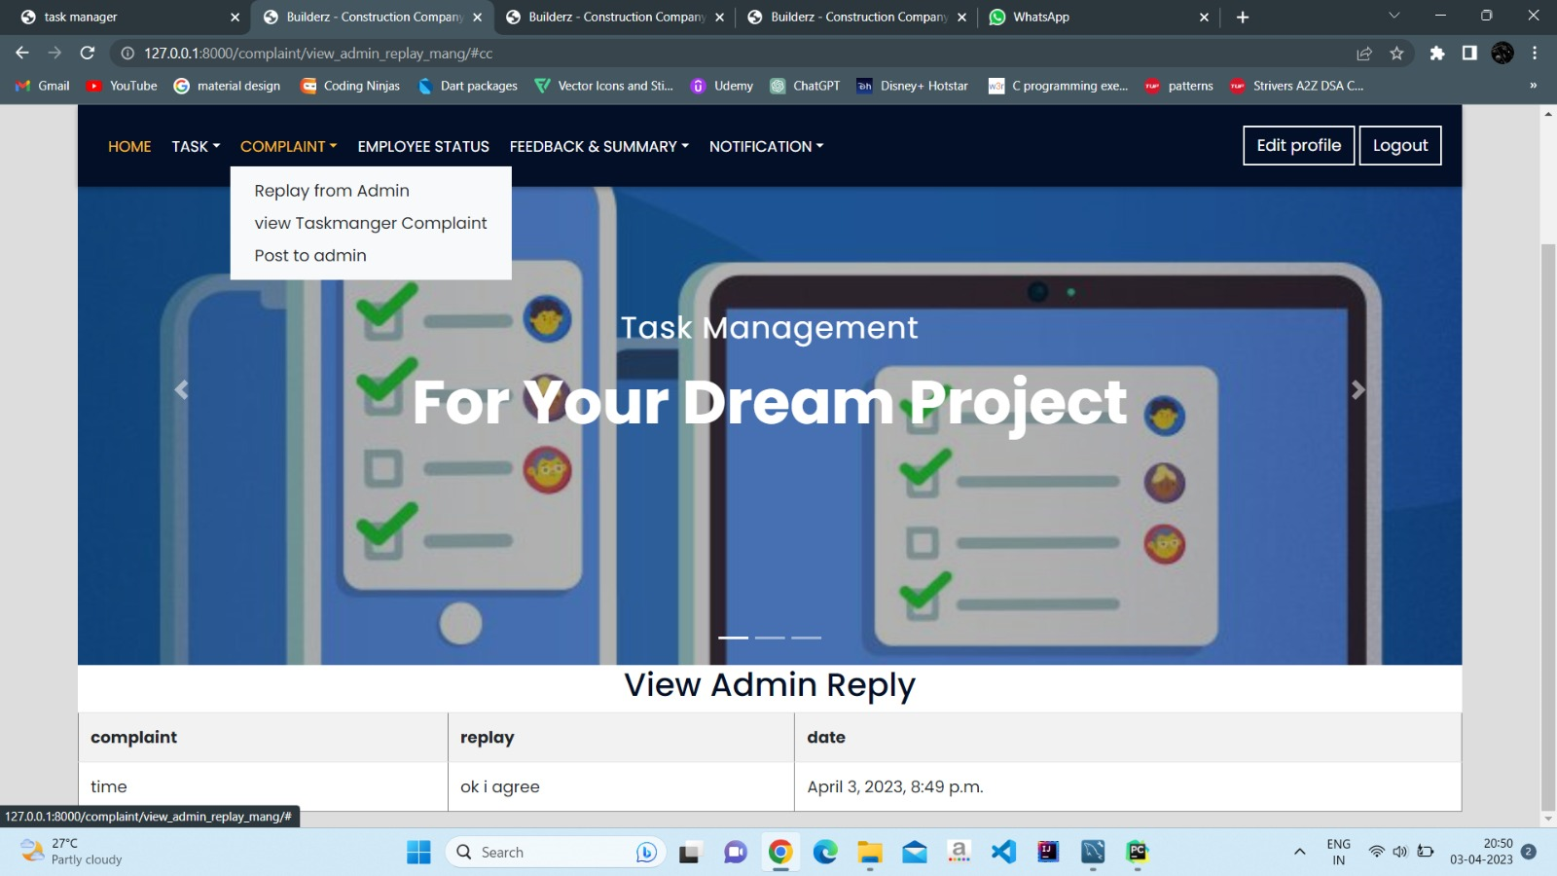

Slide 59
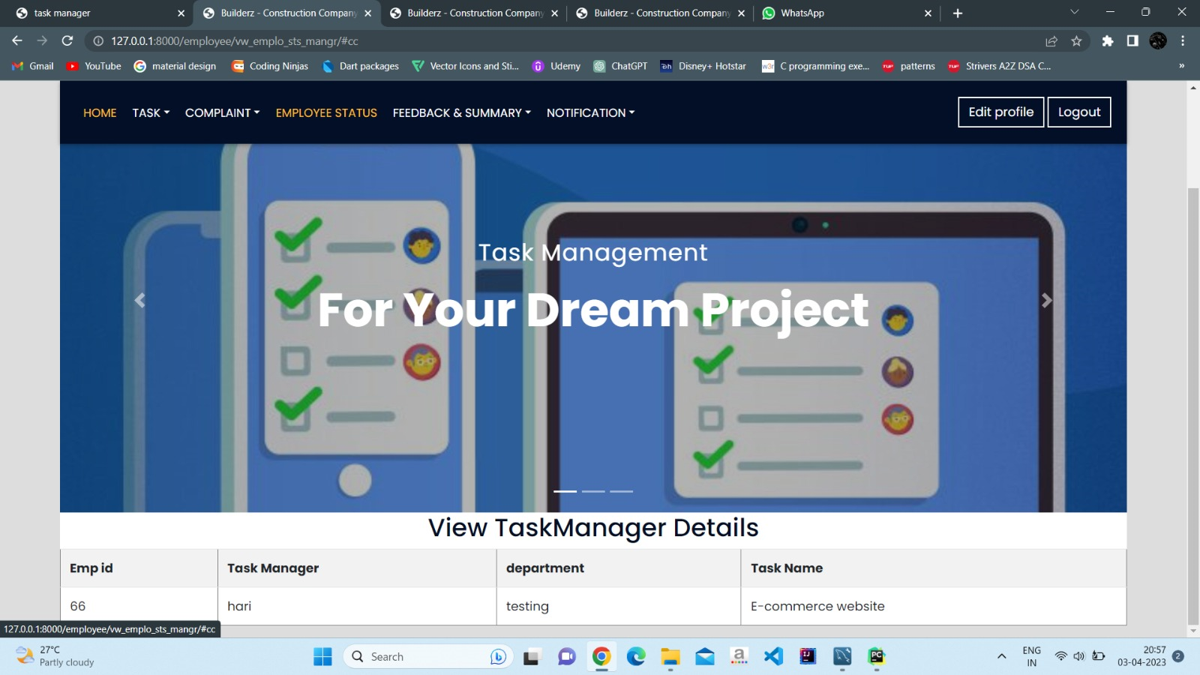

Slide 60
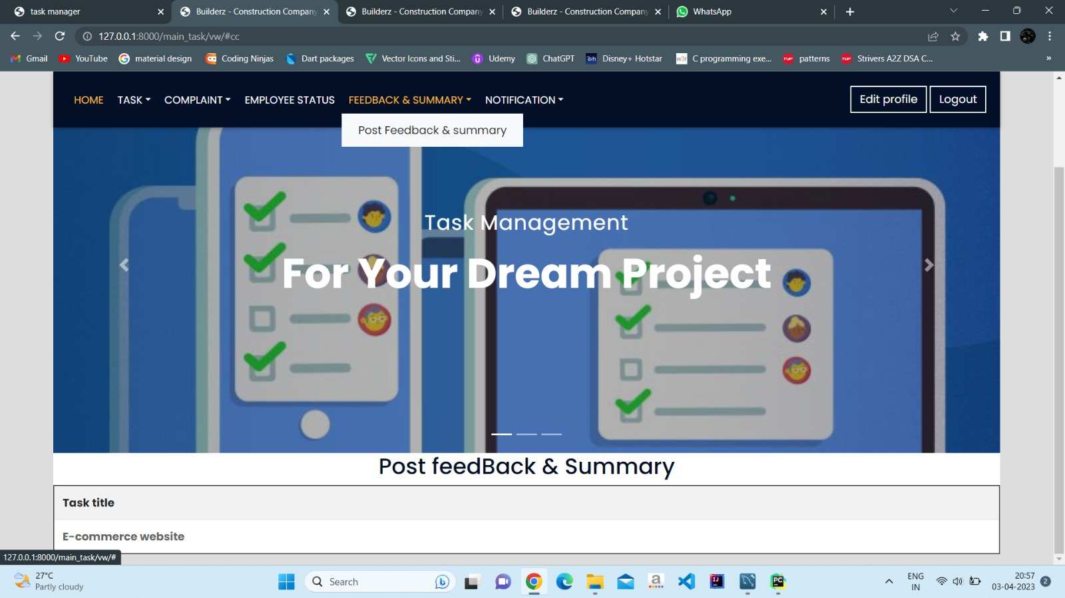

Slide 61
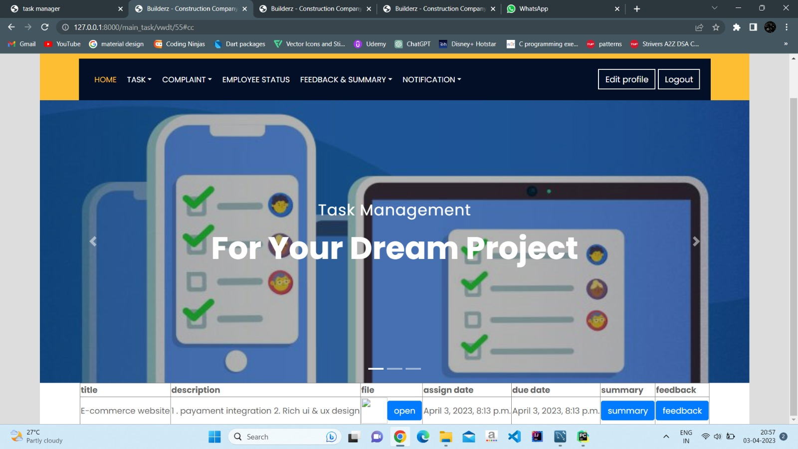

Slide 62
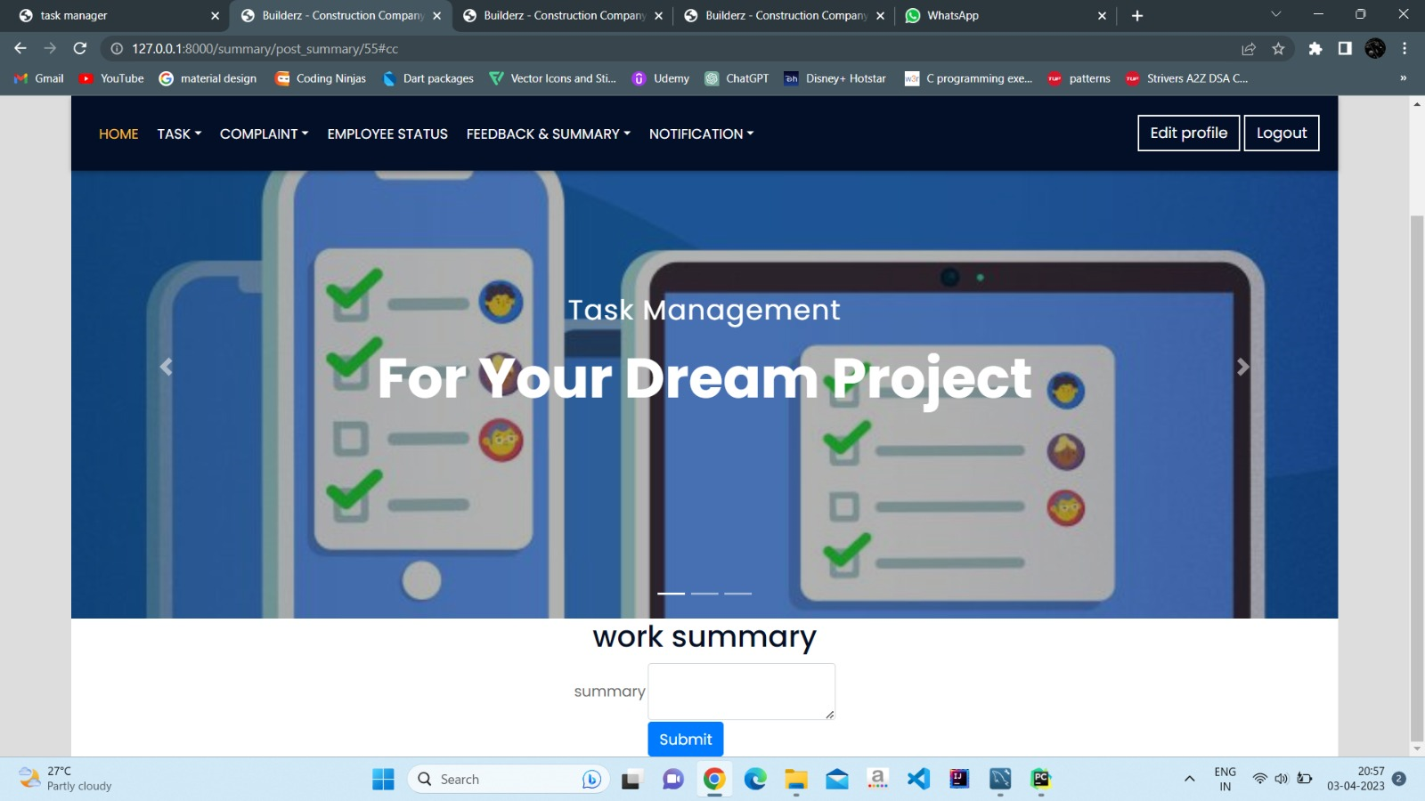

Slide 63


Slide 64
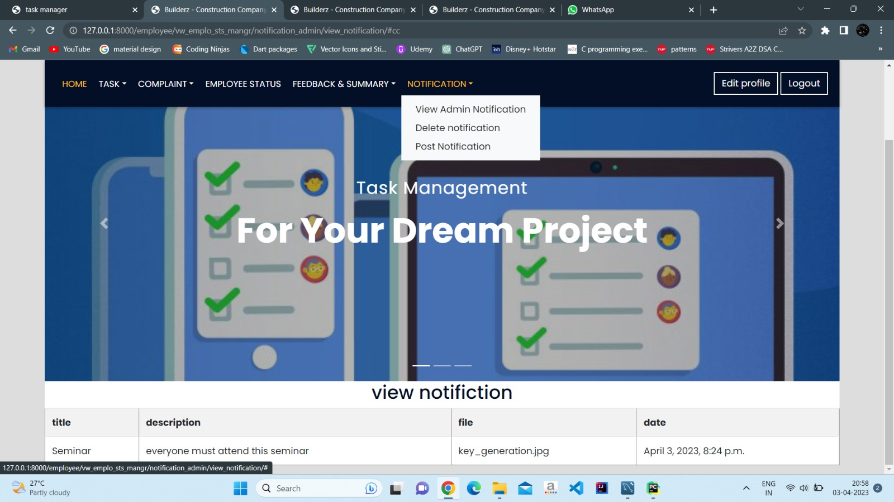

Slide 65
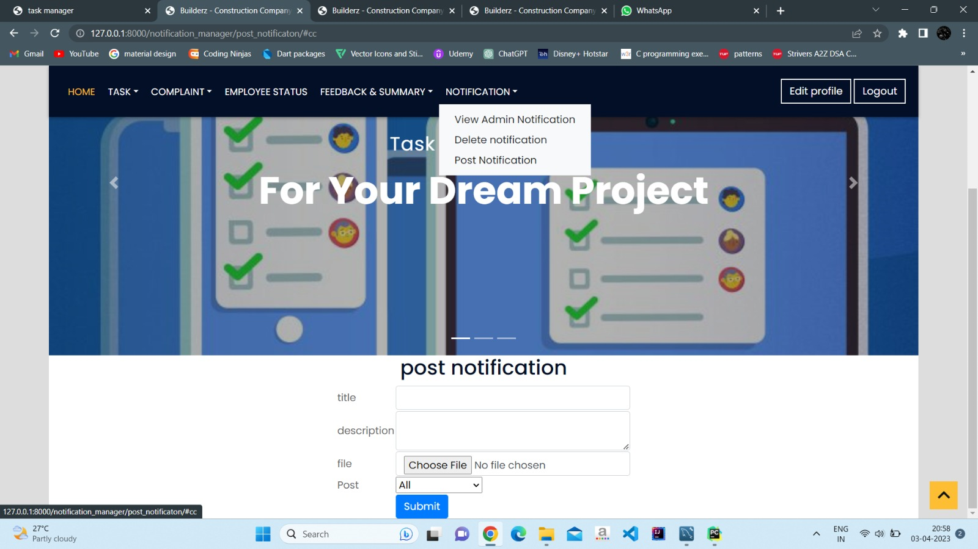

Slide 66
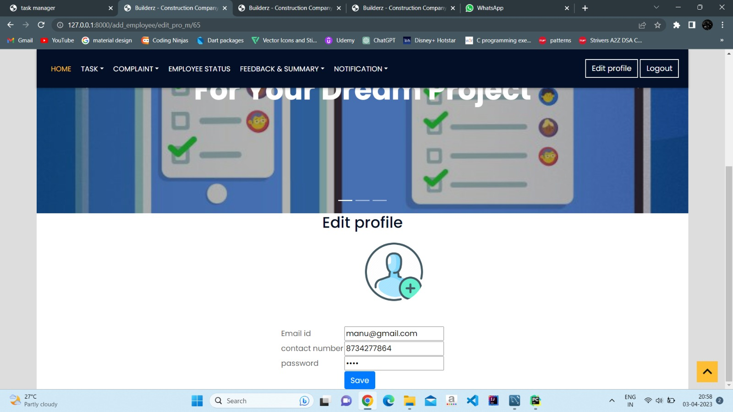

Slide 67
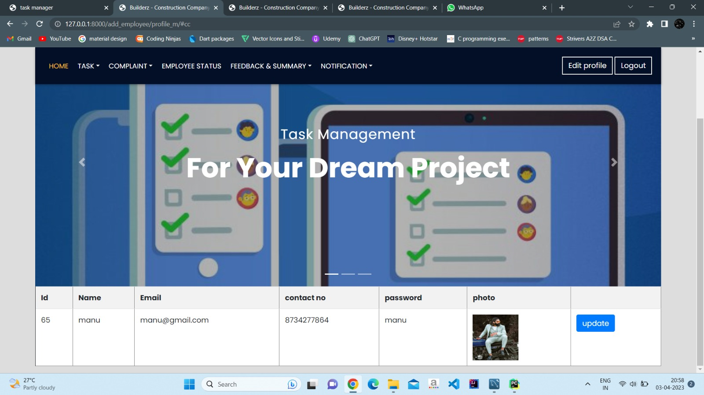

Slide 68
Task Manager page

Slide 69
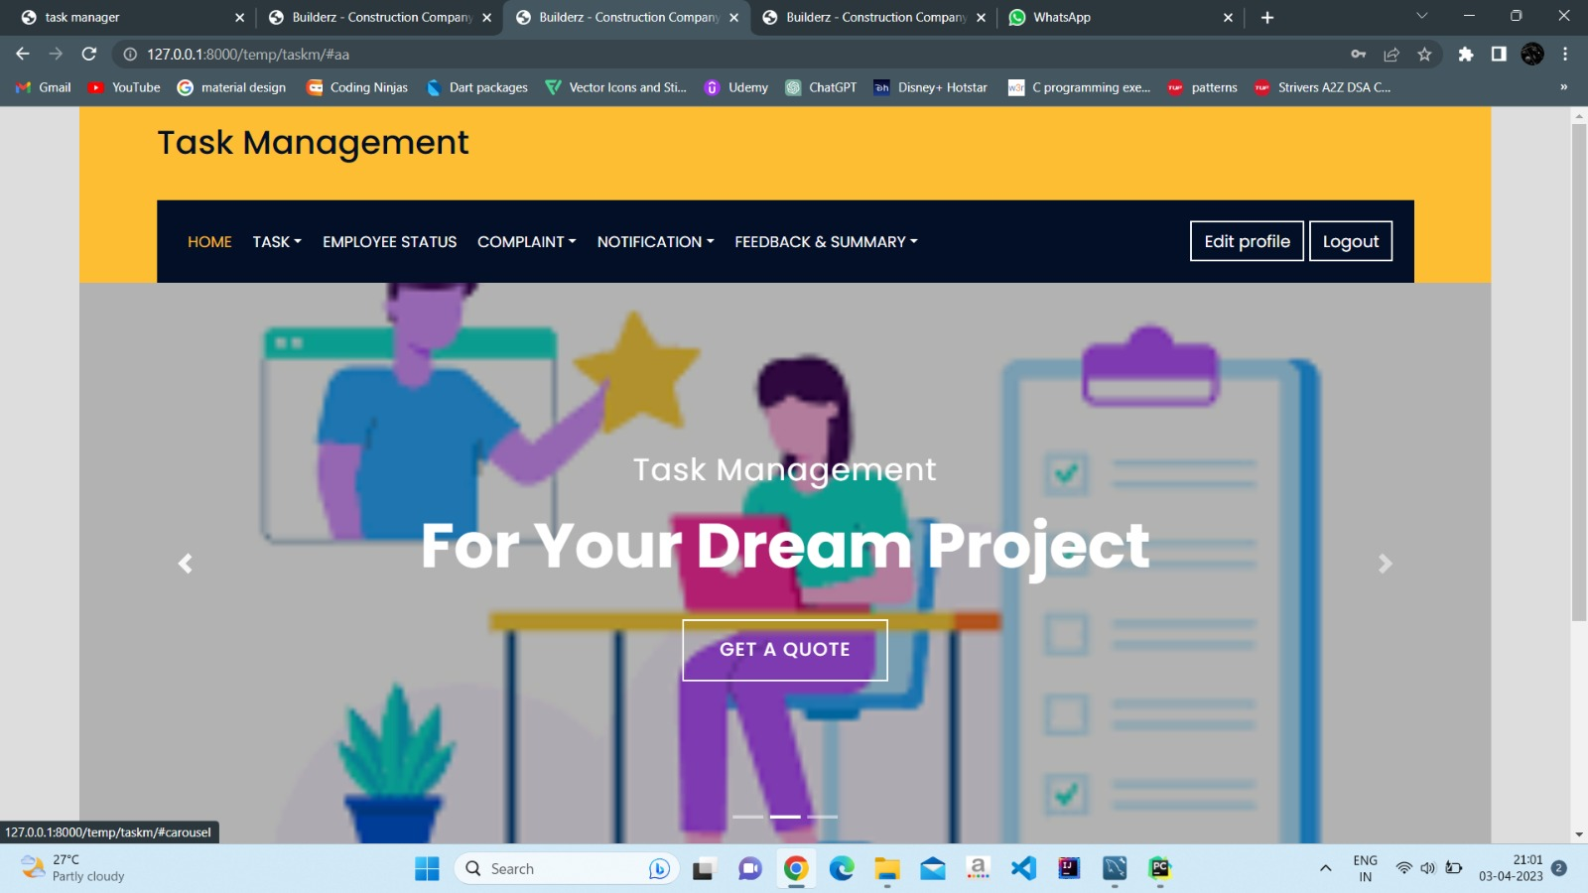

Slide 70
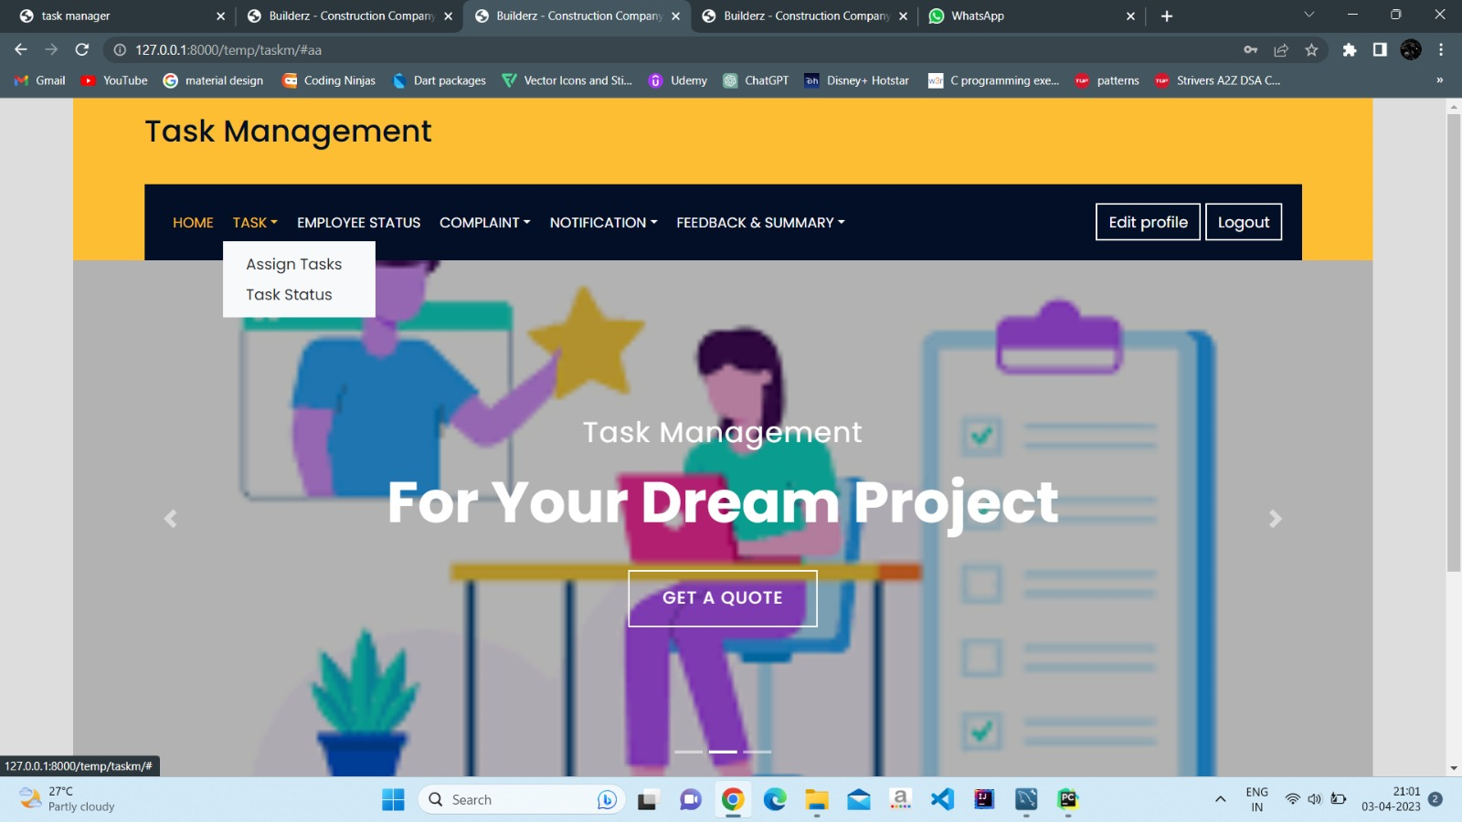

Slide 71
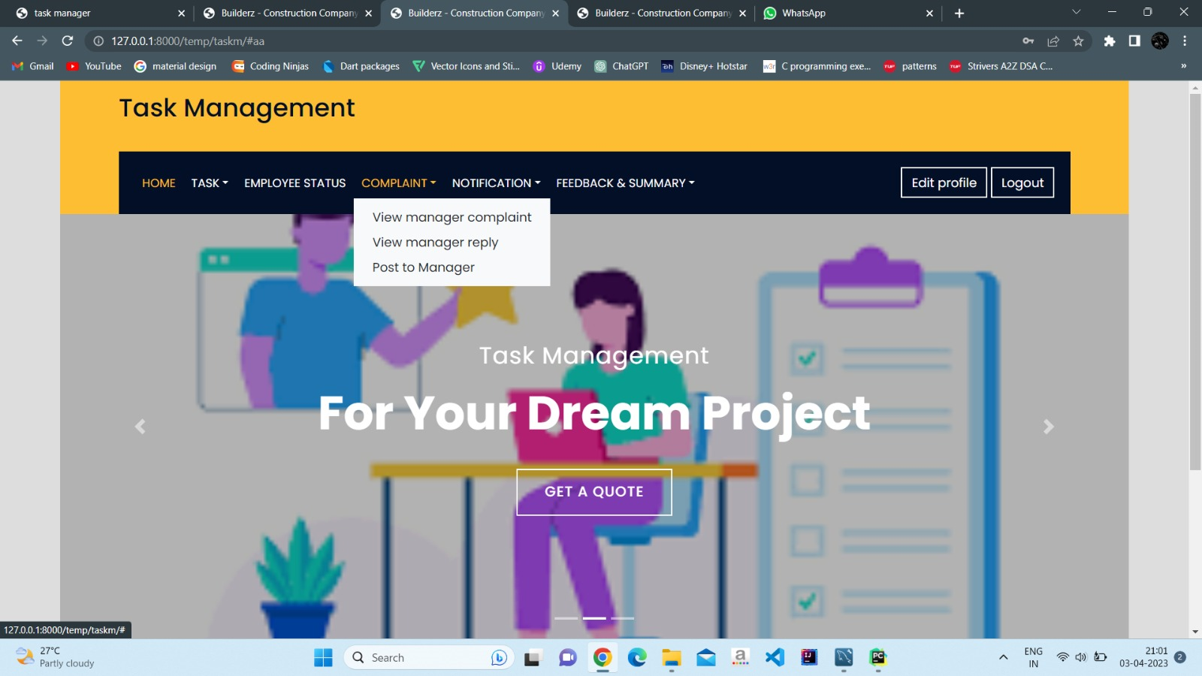

Slide 72
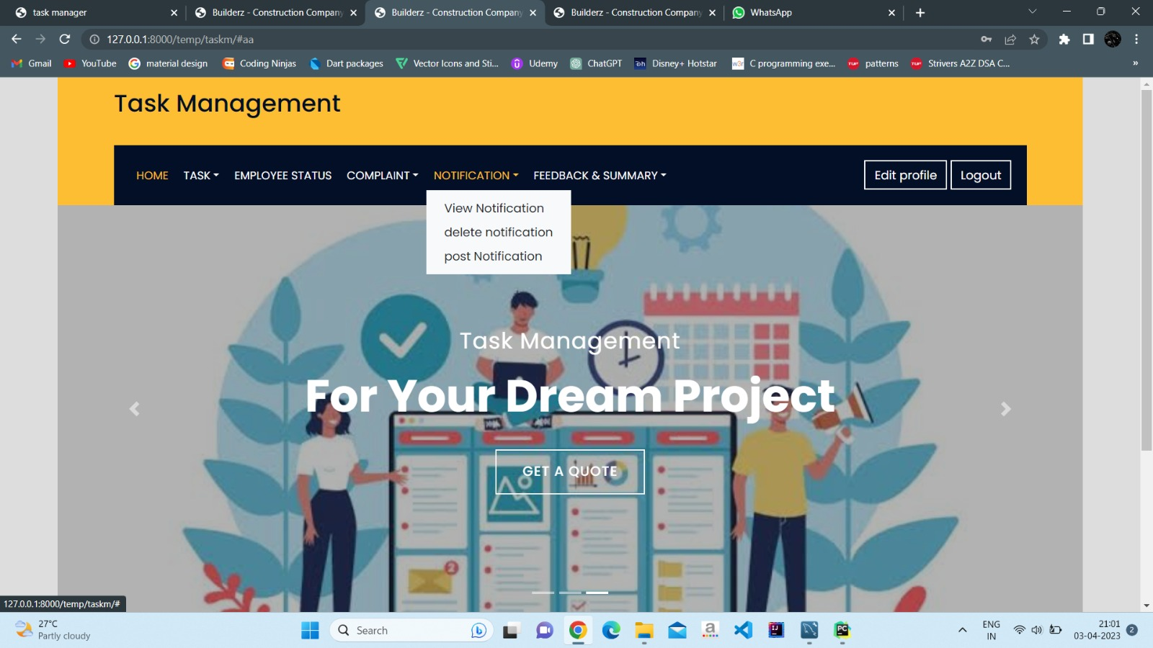

Slide 73
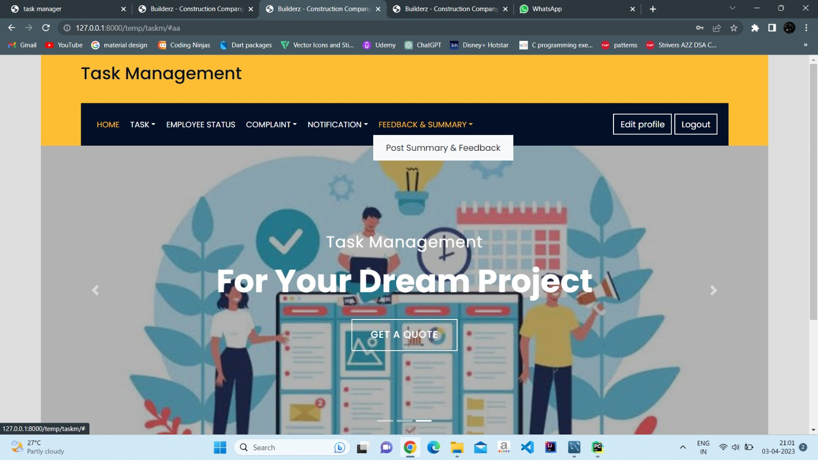

Slide 74
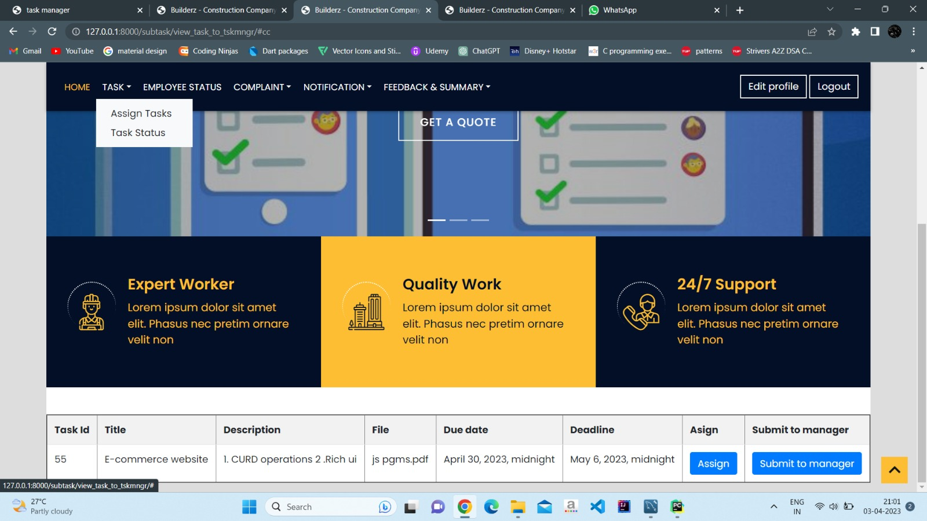

Slide 75
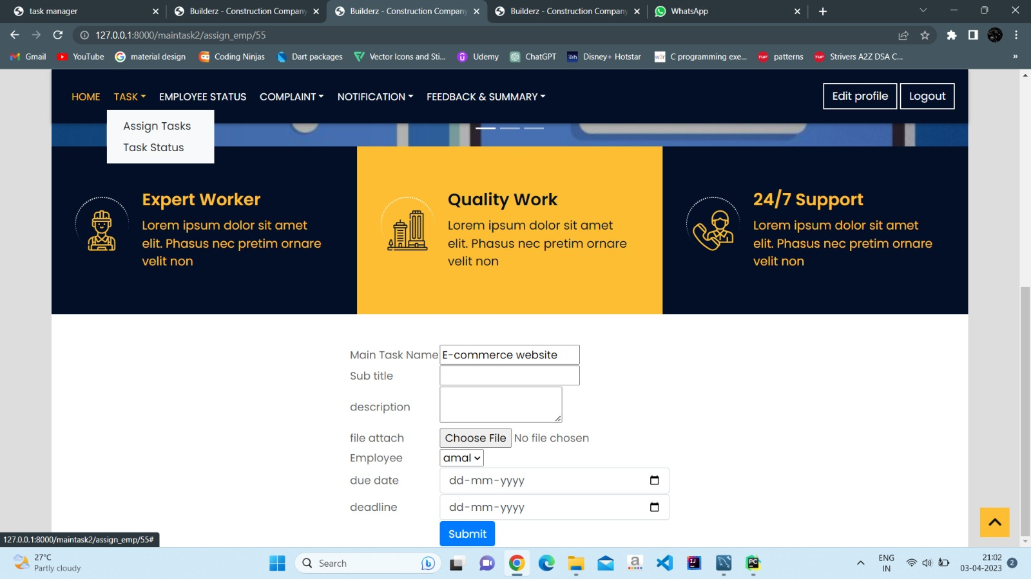

Slide 76
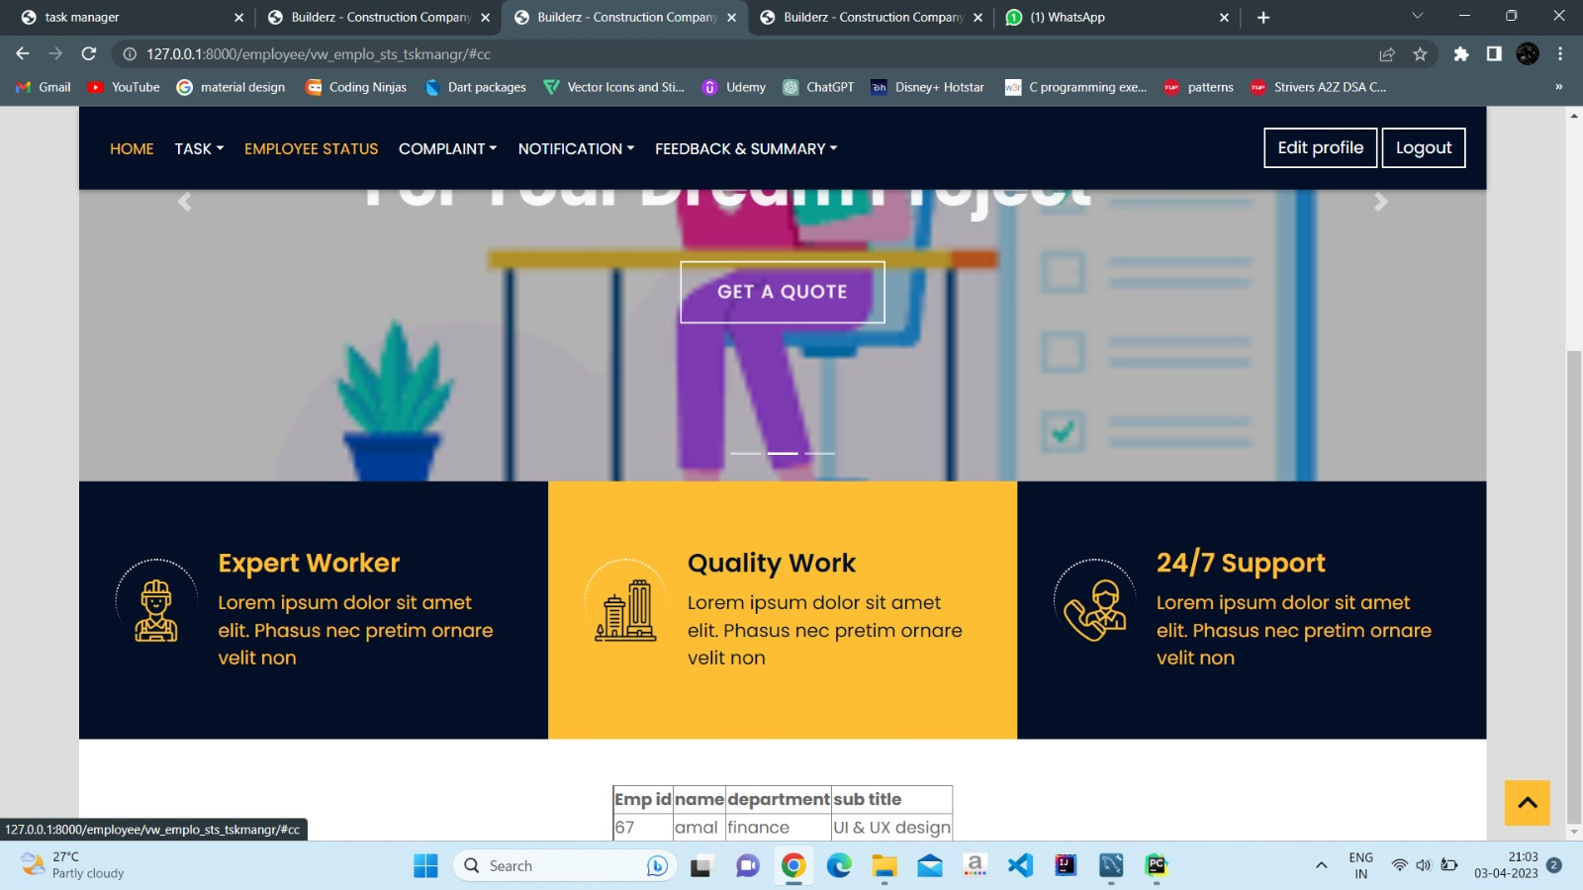

Slide 77
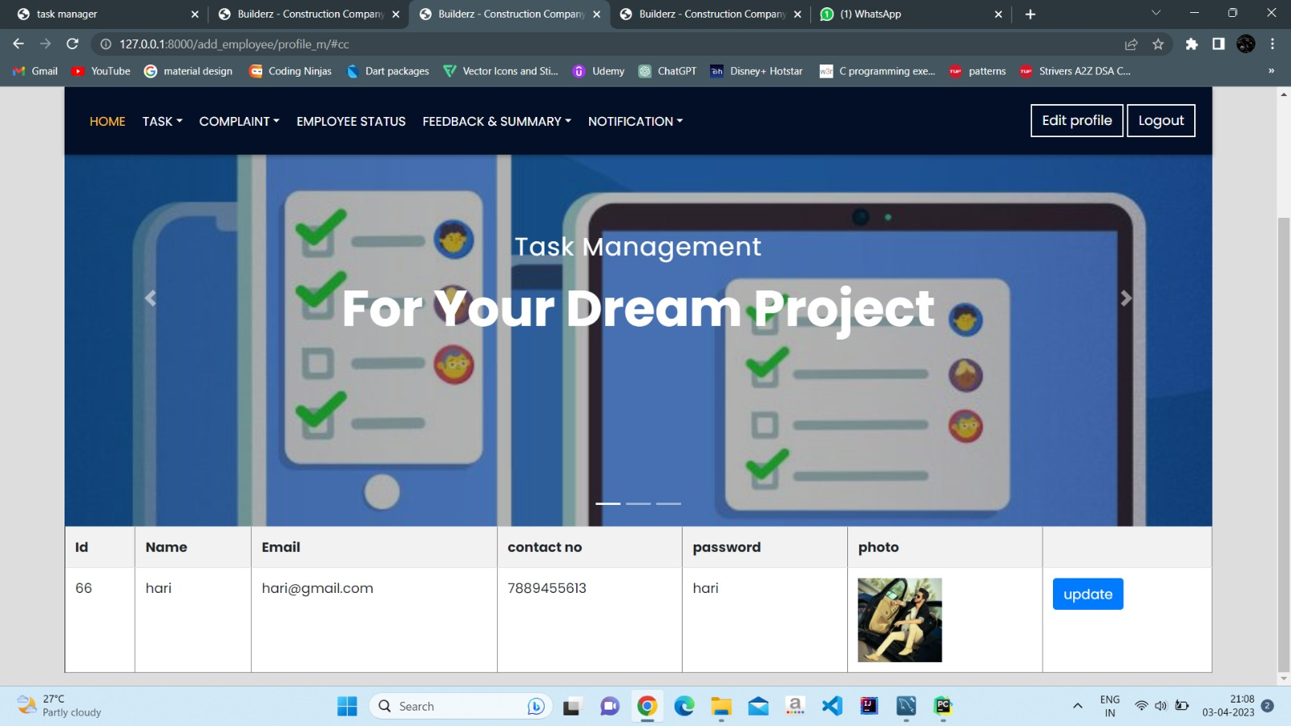

Slide 78
Employee page

Slide 79
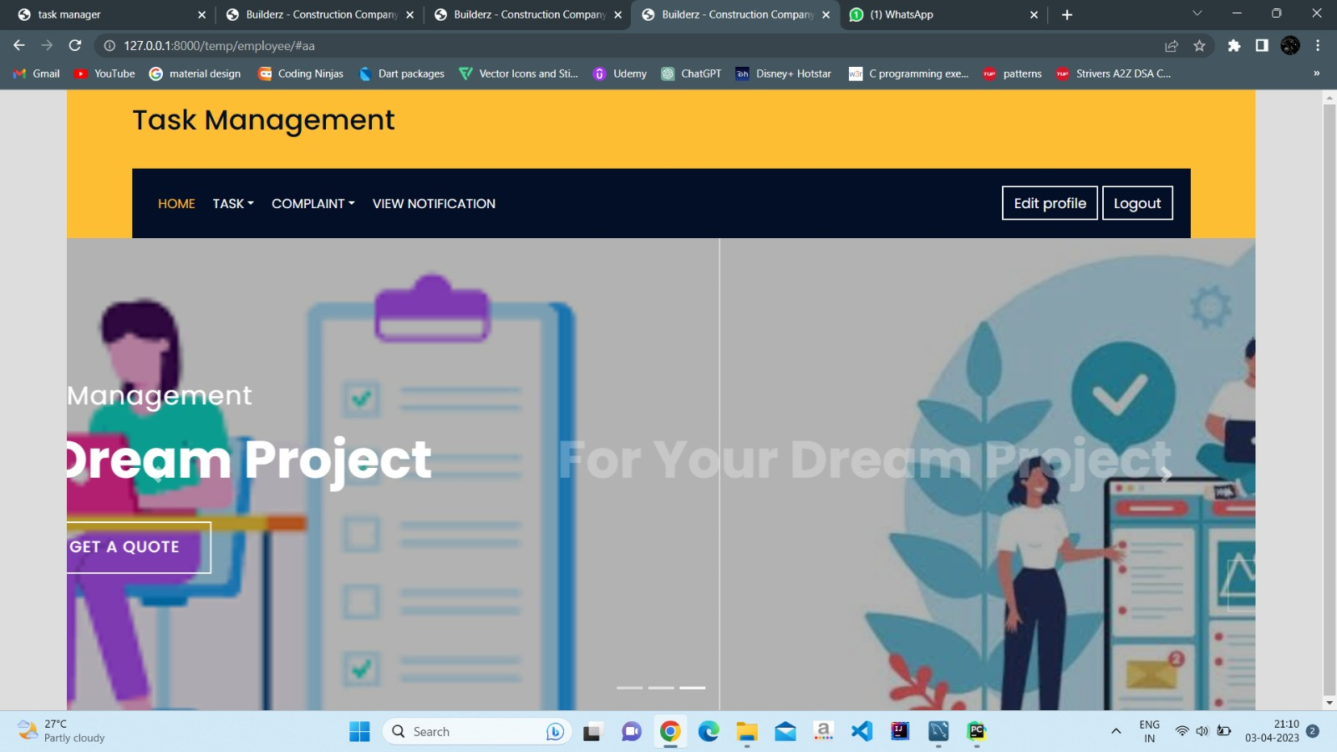

Slide 80


Slide 81


Slide 82
CONCLUSION

Slide 83
CONCLUSION
The project report entitled “TASK MANAGEMENT “has come to its final stage. The system has been developed with much care that it is free of errors and at the same time it is efficient and less time consuming. The important thing is that the system is robust. We have tried our level best to make the site as dynamic as possible. Also, provision is provided for future developments in the system. The entire system is secured. This online system will be approved and implemented soon.

Slide 84
REFERANCE
WEBSITE:
W3SCHOOLS
TUTORIALS POINT
STACK OVERFLOW
BOOKS:
Hands-On Software Engineering with Python: Move Beyond Basic Programming and Construct Reliable and Efficient Software with Complex Code By Brian Allbee.
MySQL Books: Introducing Inorb Cluster By Charles Bell;
Software engineering Roges.s pressman, web programming with HTML, XHTML, CSS Jon Duckett

Slide 85
Overview
A task management is software tool designed to help teams efficiently organize,track and complete tasks.
These applications typically developed for software companies it offers features such as task creation, assignment, scheduling as well as communication tools for team collaboration.
It is specially developed for small and virtual software companies.
It is free and Open-source
It is a spiral model

Slide 86
END

